Slide 1
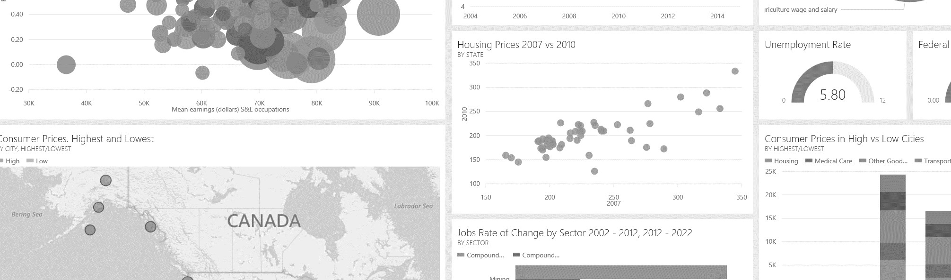
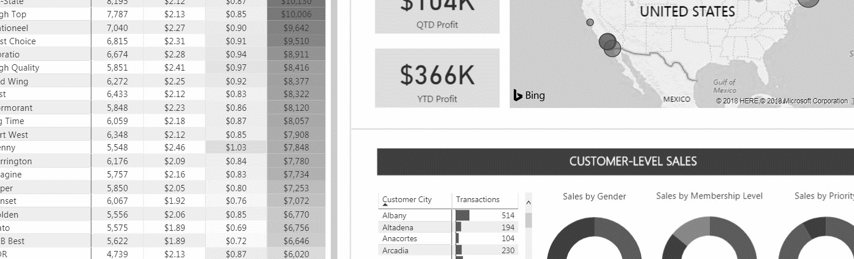


UP & RUNNING WITH

Slide 2



COURSE STRUCTURE
This is a project-based course designed for students looking for a practical, hands-on, and highly engaging approach to learning Power BI Desktop for business intelligence
Course resources include:
PowerPoint Presentation (200+ slides) containing all course slides, assignments and reference materials
Quizzes and Assignments to reinforce key concepts and simulate real-world scenarios, with step-by-step solution
Complete Bonus Project to test your abilities and apply the skills developed throughout the course to a brand-new data set

Slide 3




COURSE OUTLINE
1 | Introducing Power BI Desktop | Installing Power BI Desktop, exploring the Power BI workflow, comparing Power BI vs. Excel, etc.
2 | Connecting & Shaping Data | Connecting to data, shaping & transforming tables, using profiling tools, editing, merging & appending queries, etc.
3 | Creating a Data Model | Building relational models, creating table relationships, understanding cardinality and filter flow, etc.
4 | Calculating Measures with DAX | Understanding DAX syntax, adding calculated columns and measures, writing common formulas and functions, etc.
5 | Visualizing Data with Dashboards | Inserting charts and visuals, customizing formats, editing interactions, applying filters and bookmarks, etc.
6 | Optimizing Power BI Performance | Exploring common Power BI optimization tools within the Optimize and External tools menus

Slide 4



SETTING EXPECTATIONS
What you see on your screen may not always match mine
Power BI Desktop features are updated frequently, with new versions released each month
NOTE: Power BI is currently only compatible with PC/Windows (not available for Mac)
This course is designed to help you build foundational skills
Our goal is to help you build a deep foundational understanding of the Power BI desktop workflow; some topics may be simplified, and we won’t cover some advanced tools (M code, advanced DAX, R/Python visuals, etc.)
3
This is a hands-on and project-based learning experience
You will get the most value out of this course if you follow along closely with the demos and assignments; we’ll be working through the entire BI workflow to create a professional-quality dashboard from scratch

Slide 5

INTRODUCING POWER BI

Slide 6






MEET POWER BI
In this section we’ll introduce Power BI Desktop, review the download and installation process, adjust default settings, and explore the Power BI interface and workflow
TOPICS WE’LL COVER:
GOALS FOR THIS SECTION:
Download and install Power BI Desktop, and adjust the settings for our course project
Introducing Power BI
Power BI vs. Excel
Understand the role that Power BI plays within the broader Microsoft ecosystem
Installation Options
Adjusting Settings
Explore core components of the Power BI Desktop interface
Interface & Workflow
Helpful Resources
Review the business intelligence workflow that we’ll follow as we build our course project

Slide 7
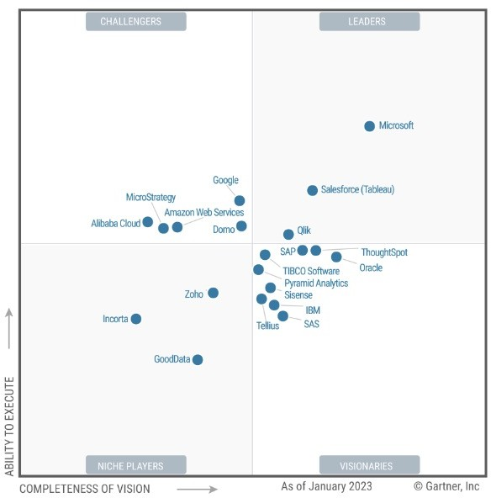

MEET POWER BI
Microsoft Power BI is a self-service business intelligence platform, which includes both desktop and web-based applications for connecting, modeling, and visualizing data
Learn more at powerbi.microsoft.com

Slide 8









WHY POWER BI?
Connect, transform and load millions of rows of data
Access data from virtually anywhere (database tables, flat files, web, cloud services, folders, etc.), and create fully automated workflows to extract, transform and load data for analysis
Build relational models to blend data from multiple sources
Create table relationships to analyze holistic performance across an entire relational data model
Define complex calculations using Data Analysis Expressions (DAX)
Enhance datasets and enable advanced analytics with powerful and portable DAX expressions
Bring data to life with interactive reports and dashboards
Build professional-quality reports and dashboards with best-in-class visualization tools
Develop a versatile, in-demand skill set
Power BI is the industry leader in self-service BI, and the skills you build in this course will be highly transferrable

Slide 9

EXCEL VS. POWER BI
EXCEL
POWER BI
Excel and Power BI are built on top of the same analytics engines
Power BI takes the same data transformation and modeling capabilities and adds powerful visualization and publishing tools
Transitioning is easy; you can import an entire data model directly from Excel!
Spreadsheets
Report View
Power Query
Data Model DAX
PivotTables
Custom Visuals
A1 Notation
Interactive Dashboards
Cell Formulas
Power BI Service

Slide 10

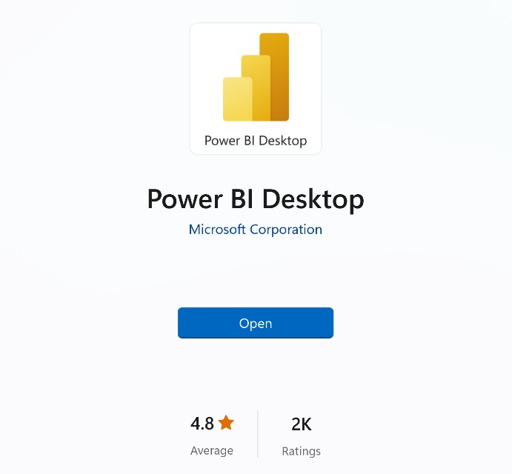
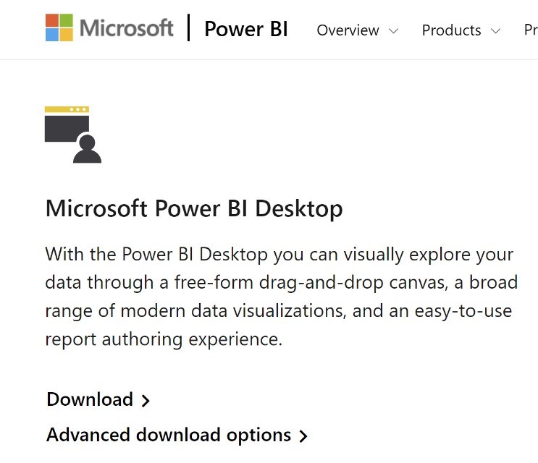




INSTALLING POWER BI DESKTOP
1) Download from Microsoft store
apps.microsoft.com
2) Download manually from web
powerbi.microsoft.com/downloads
3) Install as part of Microsoft 365
microsoft.com/en-us/microsoft-365
Power BI Desktop is included as part of select enterprise Office/Microsoft 365 subscriptions
If your company uses a compatible version of Microsoft 365, talk to an admin about getting access to Power BI
Get
Windows handles automatic updates
Updates only elements that have been changed
Doesn’t require administrator access
No automatic updates (allows version control)
Downloads an executable installation file
Administrator access may be required
HEY THIS IS IMPORTANT!
You do NOT need to register for a Power BI Pro account to access Power BI Desktop

Slide 11



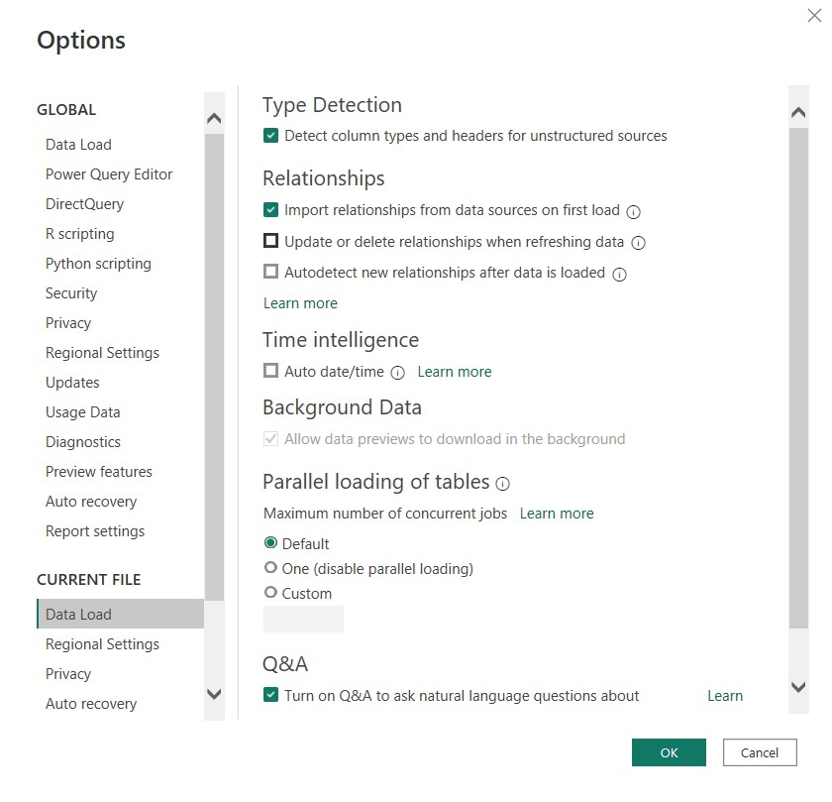
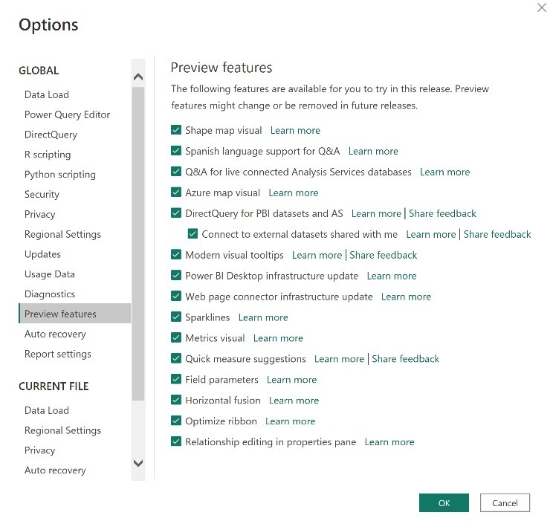



POWER BI SETTINGS
Global > Preview Features
Current File > Data Load
Current File > Regional Settings
Select all available preview features by default (these change with each monthly release)
Make sure the following options are NOT selected:
Update or delete relationships when refreshing data
Autodetect new relationships after data is loaded
Time Intelligence > Auto date/time
Select “English (United States)” from the dropdown menu (this will align with the data in course project files)
HEY THIS IS IMPORTANT!
Options under CURRENT FILE need to be adjusted every time you open a new Power BI workbook (these settings do not persist across new .pbix files)

Slide 12
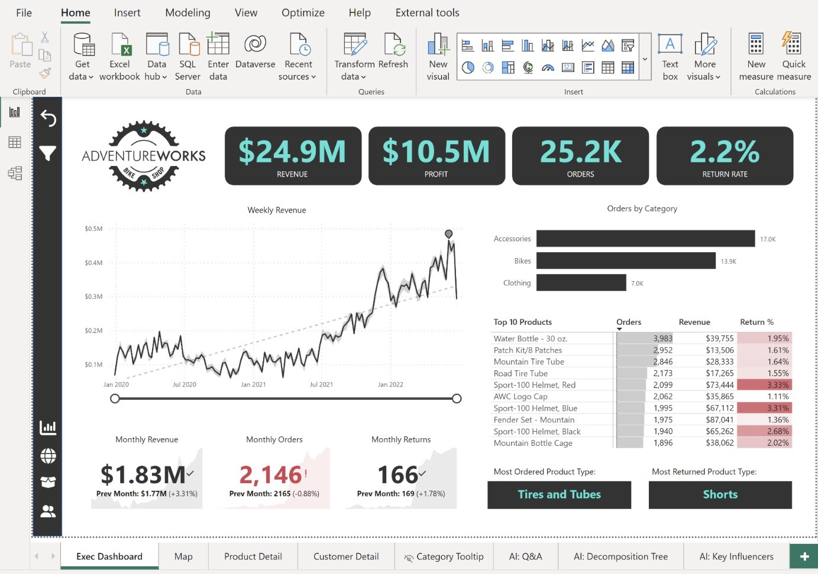

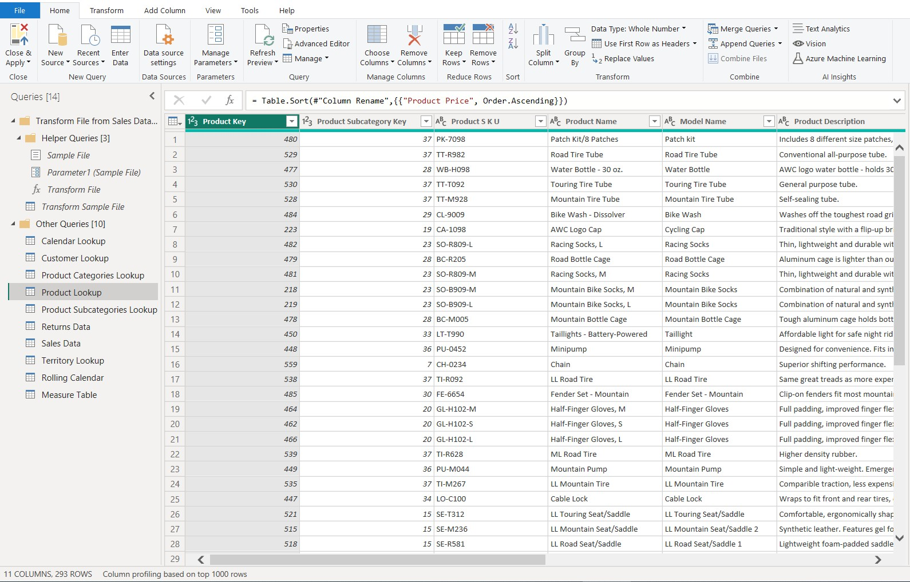




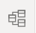

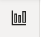
POWER BI WORKFLOW
Raw data is extracted and transformed in the Power Query editor, then loaded to the Power BI “front-end”
Power Query Editor
Model View
Data View
Report View
Power BI “Back-End”
Power BI “Front-End”

Slide 13





POWER BI WORKFLOW
Power Query Editor
Model View
Data View
Report View
Data is loaded & transformed in the Power Query Editor

Slide 14

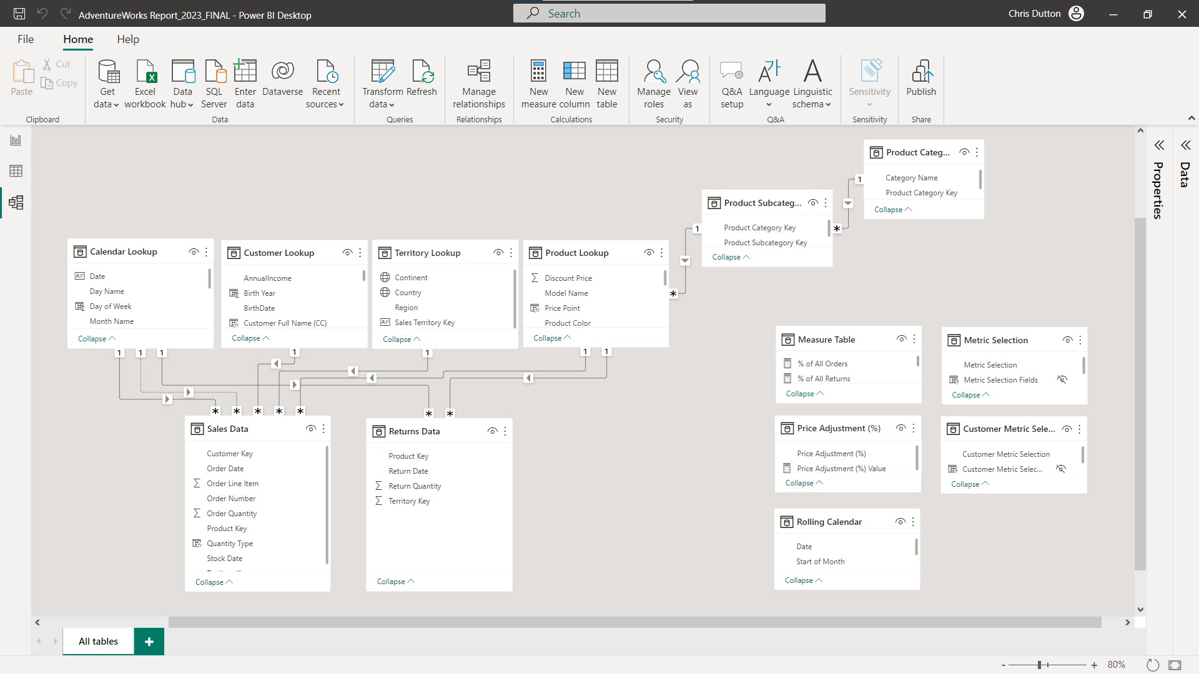


POWER BI WORKFLOW
Power Query Editor
Model View
Data View
Report View
Data is loaded & transformed in the Power Query Editor
Data models are configured in the Model View

Slide 15
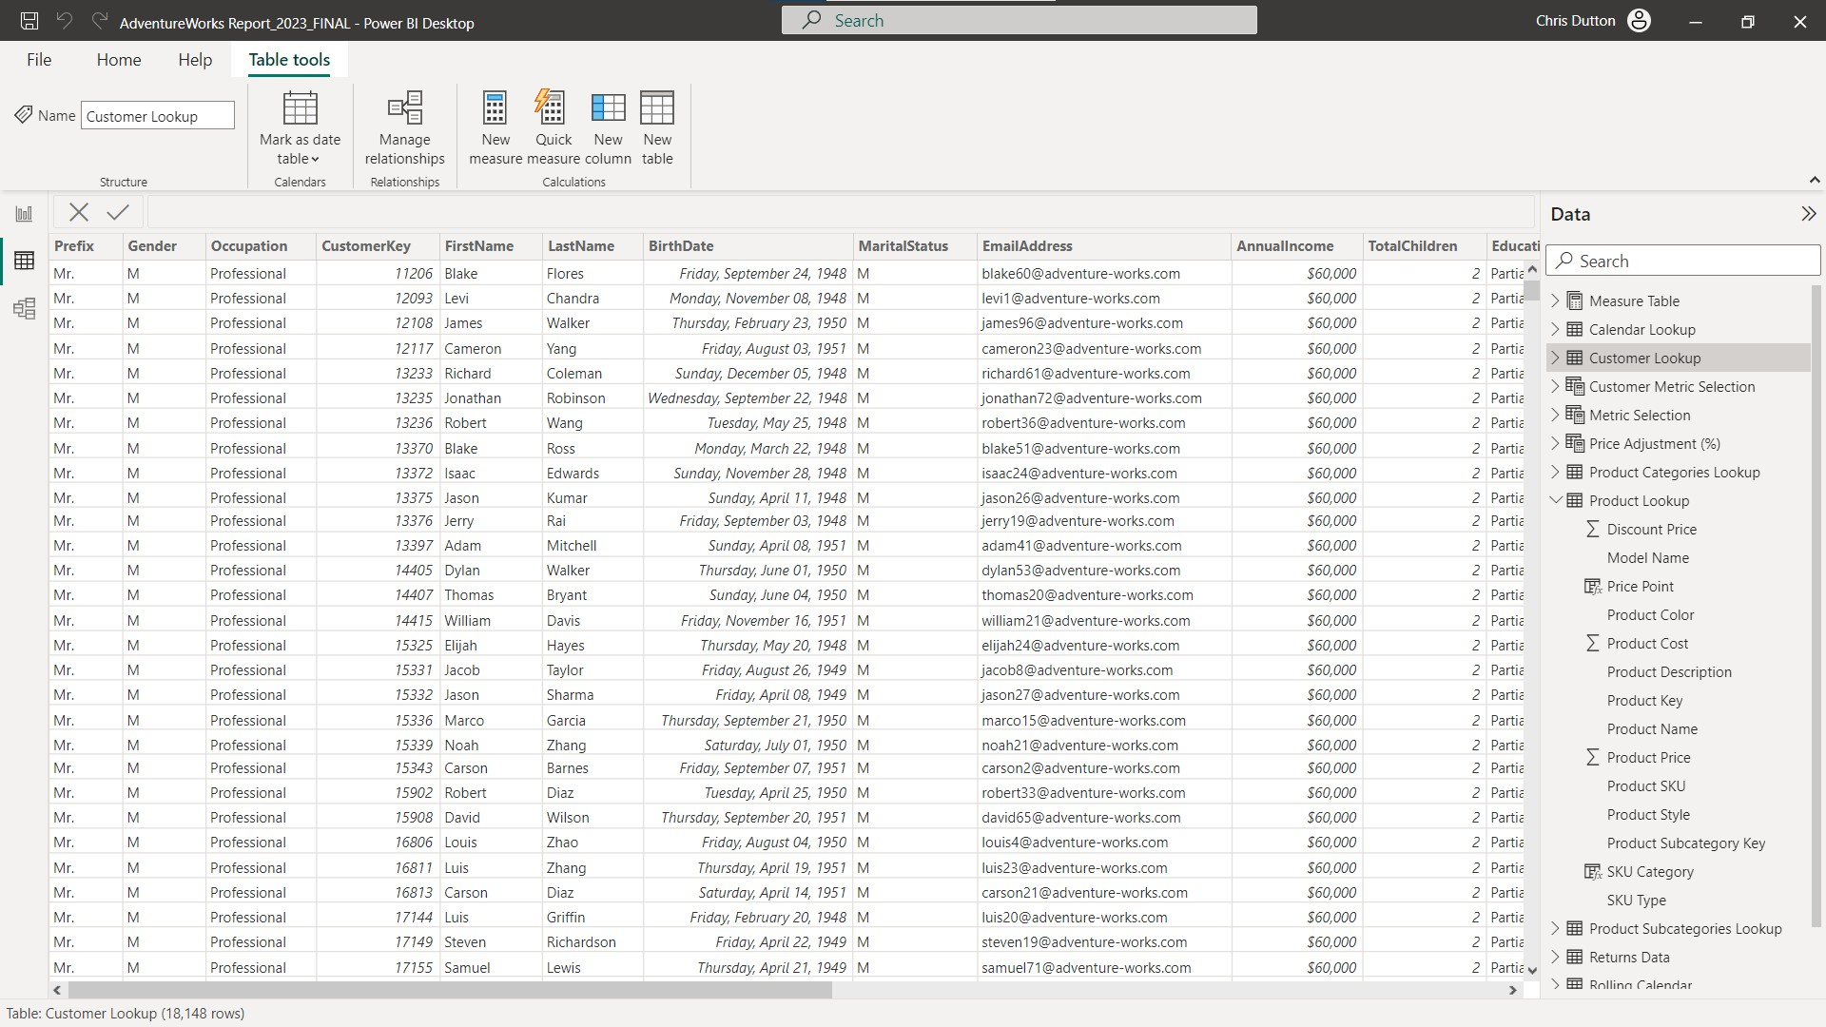


POWER BI WORKFLOW
Power Query Editor
Model View
Data View
Report View
Data is loaded & transformed in the Power Query Editor
Data models are configured in the Model View
Table features & calculations are added in the Data View

Slide 16

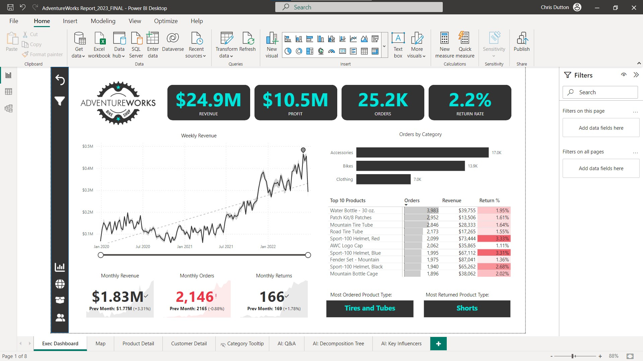


POWER BI WORKFLOW
Power Query Editor
Model View
Data View
Report View
Data is loaded & transformed in the Power Query Editor
Data models are configured in the Model View
Table features & calculations are added in the Data View
Visuals & reports are designed in the Report View

Slide 17



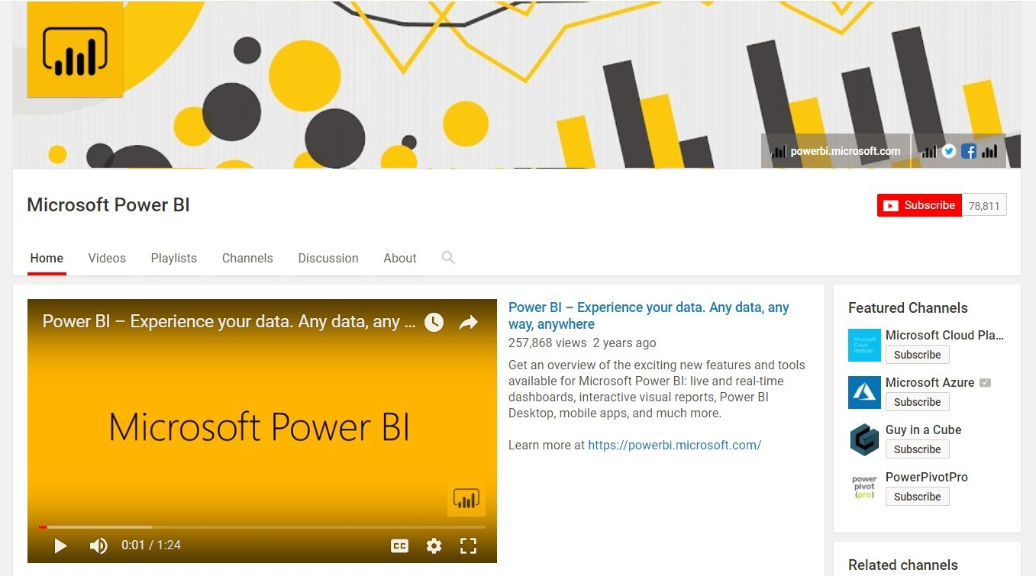

HELPFUL RESOURCES
The Help tab includes documentation, training videos, sample files, templates, and links to support blogs and communities
Update Screenshot
The Microsoft Power BI blog (powerbi.microsoft.com/blog) publishes monthly summaries to showcase new features
The Microsoft Power BI YouTube Channel publishes demos, feature summaries, and advanced tutorials (check out “Guy in a Cube” too!)
Power BI User Groups (Power BIUG) are communities of users, which include both local meet-ups and helpful online forums (pbiusergroup.com)

Slide 18




MONTHLY UPDATES
Power BI is updated monthly, so you may notice ongoing changes to settings, options, tools, etc. Reference the links below to stay up-to-date on product updates and new feature releases:
Power BI Desktop
https://docs.microsoft.com/en-us/power-bi/fundamentals/desktop-latest-update
Power BI Service
https://docs.microsoft.com/en-us/power-bi/fundamentals/service-whats-new
Power Platform
https://learn.microsoft.com/en-us/dynamics365/release-plans/

Slide 19
CONNECTING & SHAPING DATA

Slide 20

COURSE PROJECT
THE You’ve just been hired as a Business Intelligence Analyst by AdventureWorks*, a global manufacturing company that produces cycling equipment and accessories
SITUATION
The management team needs a way to track KPIs (sales, revenue, profit, returns), compare regional performance, analyze product-level trends, and identify high-value customers.
All you’ve been given is a folder of raw csv files, which contain information about transactions, returns, products, customers, and sales territories.
THE
BRIEF
Use Power BI Desktop to:
THE
Connect and transform the raw data
Build a relational data model
Create calculated columns and measures with DAX
Design an interactive dashboard to visualize the data
OBJECTIVE
*This data is provided by Microsoft for informational purposes only as an aid to illustrate a concept. These samples are provided “as is” without warranty of any kind. The example companies, organizations, products, domain names, e-mail addresses, people, places, and events depicted herein are fictitious, and no association with any real company, organization, product, domain name, e-mail address, person, place, or event is intended or should be inferred.

Slide 21






CONNECTING & SHAPING DATA
In this section we’ll connect to source files and cover some of the most common techniques for extracting, cleaning, and shaping data to prepare it for modeling and analysis
TOPICS WE’LL COVER:
GOALS FOR THIS SECTION:
Explore Power BI’s query editor and understand the role that Power Query plays in the larger BI workflow
Introduce different types of connectors and connectivity modes available for getting data into Power BI
Review tools for checking data quality and key profiling metrics like column distribution, empty values, errors and outliers
Transform tables using text, numerical and date/time tools, pivot and group records, and create new conditional columns
Practice combining, modifying and refreshing queries
Intro to Power Query
Data Connectors
The Query Editor
Connection Modes
Data QA & Profiling
Table Transformations
Calendar Tools
Combining Queries

Slide 22




FRONT-END VS. BACK-END
Power BI Desktop essentially has two distinct environments: a front-end and a back-end
The front-end includes the Data, Model & Report views, where most of the modeling, analysis and visualization takes place
The back-end includes the Power Query Editor, where raw data is extracted, transformed, and loaded to the front-end (ETL)
BACK-END
FRONT-END
Connect & extract data using pre-built connectors
Profile & QA the data to explore, clean and prepare it for modeling and analysis
Transform & shape tables to add new features, modify values, group records, or sort and filter columns
Merge or append queries to join and combine them prior to loading to the front-end
Perform advanced transformations using custom M code (out of scope for this course)
Build data models by creating table relationships between primary and foreign keys
Add calculated measures & columns using Data Analysis Expressions (DAX)
Design reports to visualize the data and create interactive, dynamic dashboards
Publish & share your Power BI workbooks using Power BI Service (cloud application)

Slide 23


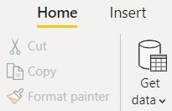

TYPES OF DATA CONNECTORS
Power BI can connect to virtually any type of source data, including (but not limited to):
Flat files & Folders (csv, text, xlsx, etc.)
Databases (SQL, Access, Oracle, IBM, etc.)
Power Platform (Datasets, Datamarts, Dataflows, Dataverse, etc.)
Azure (Azure SQL, Analysis Services, Databricks, etc.)
Online Services (SharePoint, GitHub, Dynamics 365, Google Analytics, Salesforce, Power BI Service, etc.)
Other (Web feeds, R scripts, Spark, Hadoop, etc.)

Slide 24

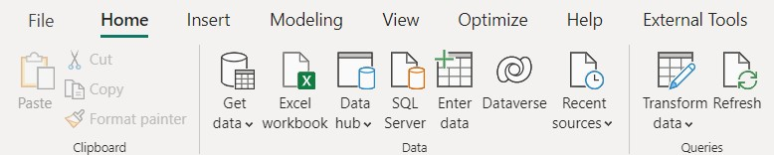



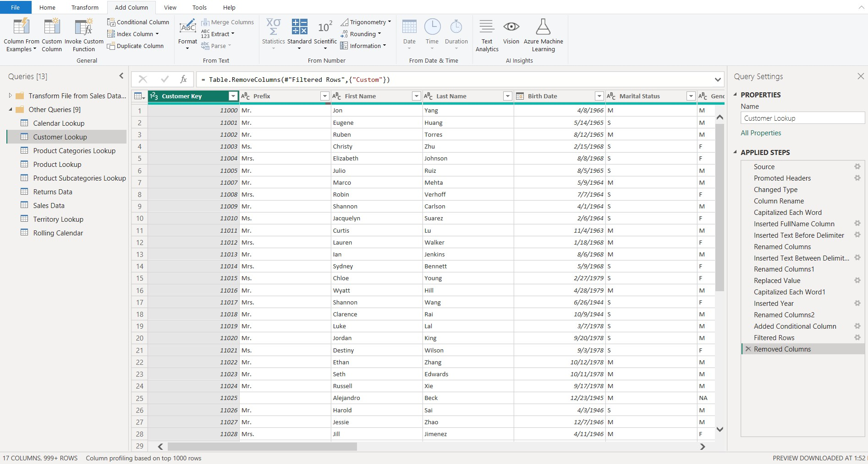



POWER QUERY EDITOR
Query Editing Tools (Table transformations, calculated columns, etc.)
Formula Bar (this is “M” code)
Table Name & Properties
Queries Pane
(list of all queries)
Applied Steps
(like a macro)
Table Preview
*In older versions of Power BI, the Transform Data option may be named “Edit Queries”

Slide 25

QUERY EDITING TOOLS
The HOME tab includes general settings and common table transformation tools
The TRANSFORM tab includes tools to modify existing columns (splitting/grouping, transposing, extracting text, etc.)
The ADD COLUMN tools create new columns (based on conditional rules, text operations, calculations, dates, etc.)

Slide 26







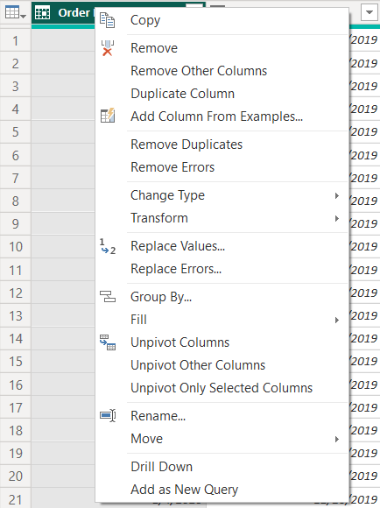



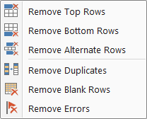
BASIC TABLE TRANSFORMATIONS
Sort values (A-Z, Low-High, etc.)
Change data type (date, $, %, text, etc.)
Promote headers
Duplicate, move or
rename columns
Tip: Right-click column headers to access common tools
Choose or remove columns
Tip: use the “Remove Other Columns” option if you always want a specific set
Keep or remove rows
Tip: use “Remove Duplicates” to create new lookup tables from scratch

Slide 27




ASSIGNMENT: TABLE TRANSFORMATIONS
NEW MESSAGE
From: Ethan T. Langer (Analytics Manager)
Subject: Welcome aboard!
Key Objectives
Create queries to connect to the two new .csv files
Name your queries Product Category Lookup and Product Subcategory Lookup
Confirm that column headers have been promoted and that all data types are correct
Add a new column to extract all characters before the dash ("-") in the Product SKU column, and name it ”SKU Type”
Update the SKU Type calculation above to return all characters before second dash, instead of the first
Replace zeros (0) in the Product Style column with “NA”
Close and load to your data model
Hello, and welcome to the team!
We’re excited that you’ll be helping us develop our new internal reports in Power BI. Looks like you’ve already gotten started, but we have some new data to add to the model.
Could you please create two new queries to connect to the Product Category Lookup and Product Subcategory Lookup files attached, and help with a few modifications to the product table?
Thanks!
-ETL
Product Category Lookup Product Subcategory Lookup

Slide 28
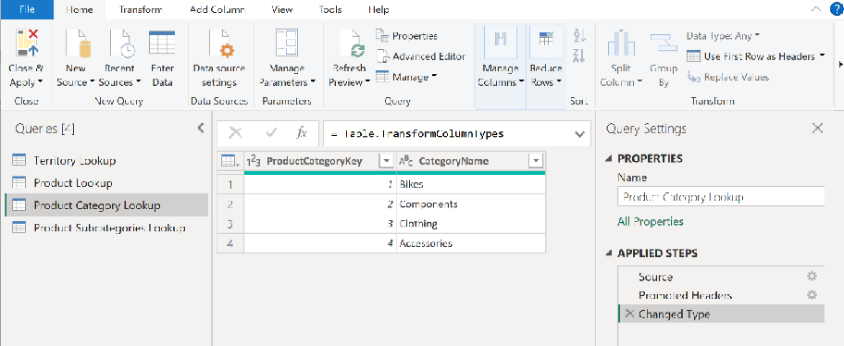

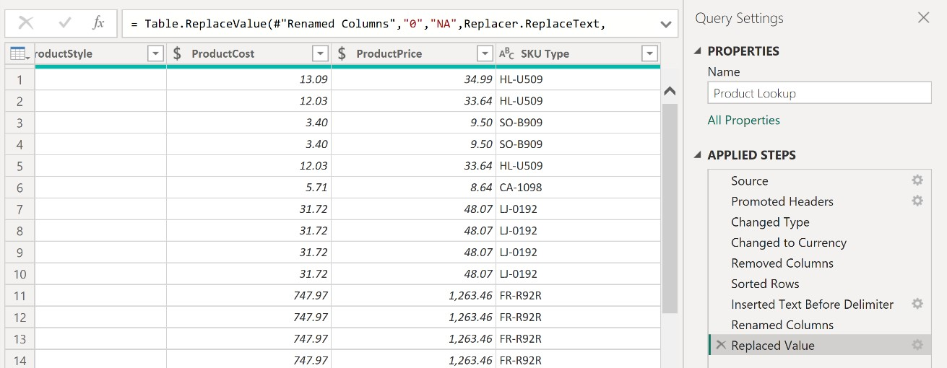
SOLUTION: TABLE TRANSFORMATIONS
NEW MESSAGE
From: Ethan T. Langer (Analytics Manager)
Subject: Welcome aboard!
Solution Preview
Hello, and welcome to the team!
We’re excited that you’ll be helping us develop our new internal reports in Power BI. Looks like you’ve already gotten started, but we have some new data to add to the model.
Could you please create two new queries to connect to the Product Category Lookup and Product Subcategory Lookup files attached, and help with a few modifications to the product table?
Thanks!
-ETL
Product Category Lookup Product Subcategory Lookup

Slide 29





PRO TIP: STORAGE & CONNECTION MODES
Power BI Desktop supports several types of storage and connection modes:
Import: Tables are stored in-memory within Power BI and queries are fulfilled by cached data (default)
DirectQuery: Tables are connected directly to the source and queries are executed on-demand at the data source
Composite Model (Dual): Tables come from a mix of Import and DirectQuery modes, or integrate multiple DirectQuery tables
Live Connection: Connect to pre-published Power BI datasets in Power BI Service or Azure Analysis Services
Import
Dataset is less than 1GB (after compression) & fast performance
Source data does not change frequently
No restrictions on Power Query, data modeling, and DAX functions
DirectQuery
Dataset is too large to be stored in-memory
Source data changes frequently and reports must reflect changes
Company policy states that data can only be accessed from the original source
Composite Model
Boost performance by setting appropriate storage for each table
Combine a DirectQuery model with additional imported data
Create a single model from two or more DirectQuery models
Live Connection
Create one dataset that serves as a central source of truth
Analyst teams can create different reports from the same source
Multi-developer teams where one user builds the model and another works on visualization
Learn more: https://learn.microsoft.com/en-us/power-bi/connect-data/service-dataset-modes-understand

Slide 30

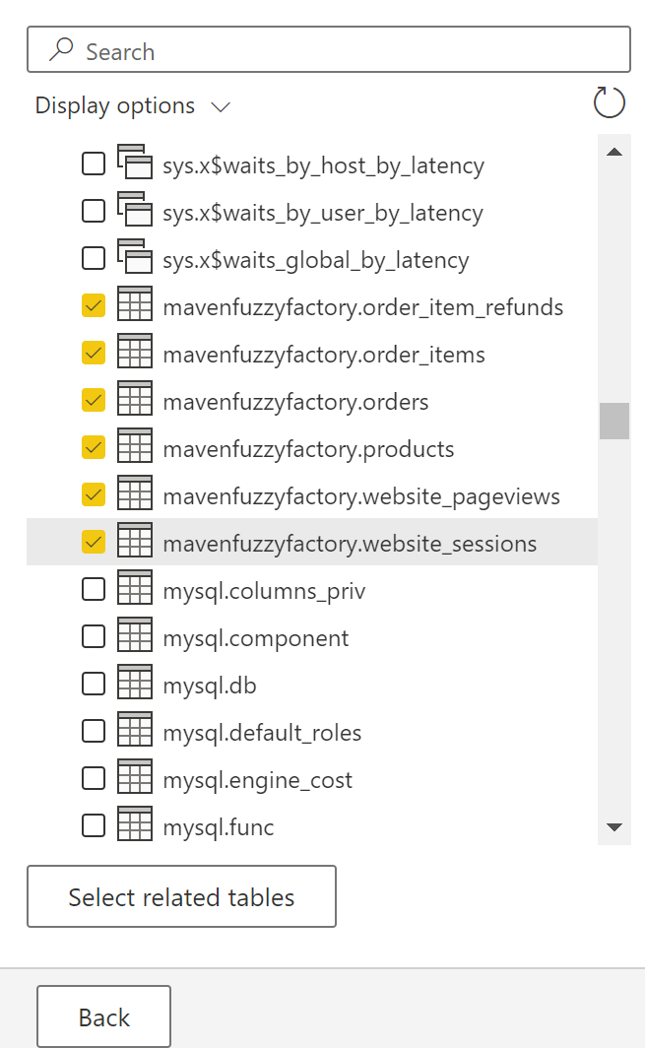



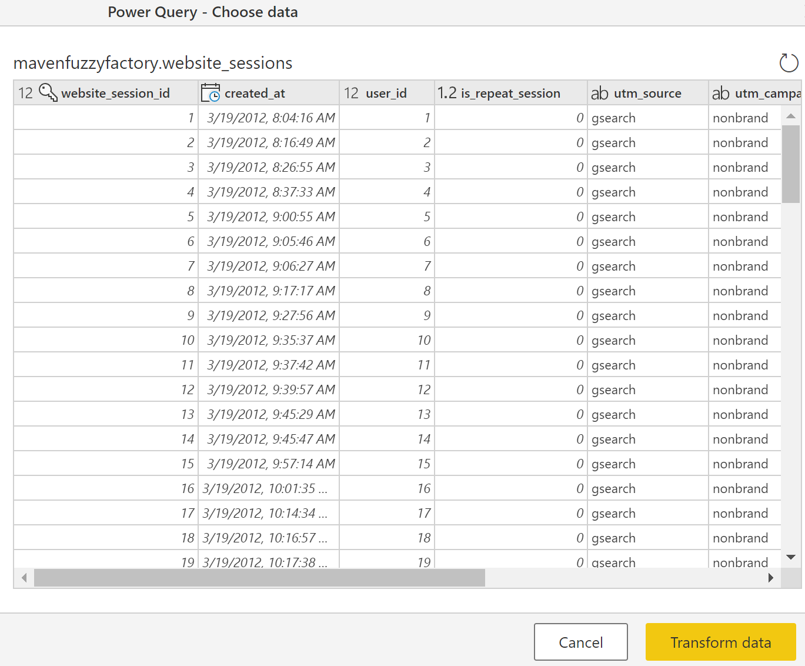

CONNECTING TO A DATABASE
Power Query can connect to data from various database sources including SQL Server, MS Access, MySQL, PostgreSQL, Oracle, SAP, and more
Select tables & transform
Get Data & enter credentials
Write custom or advanced queries with SQL statements (optional)

Slide 31

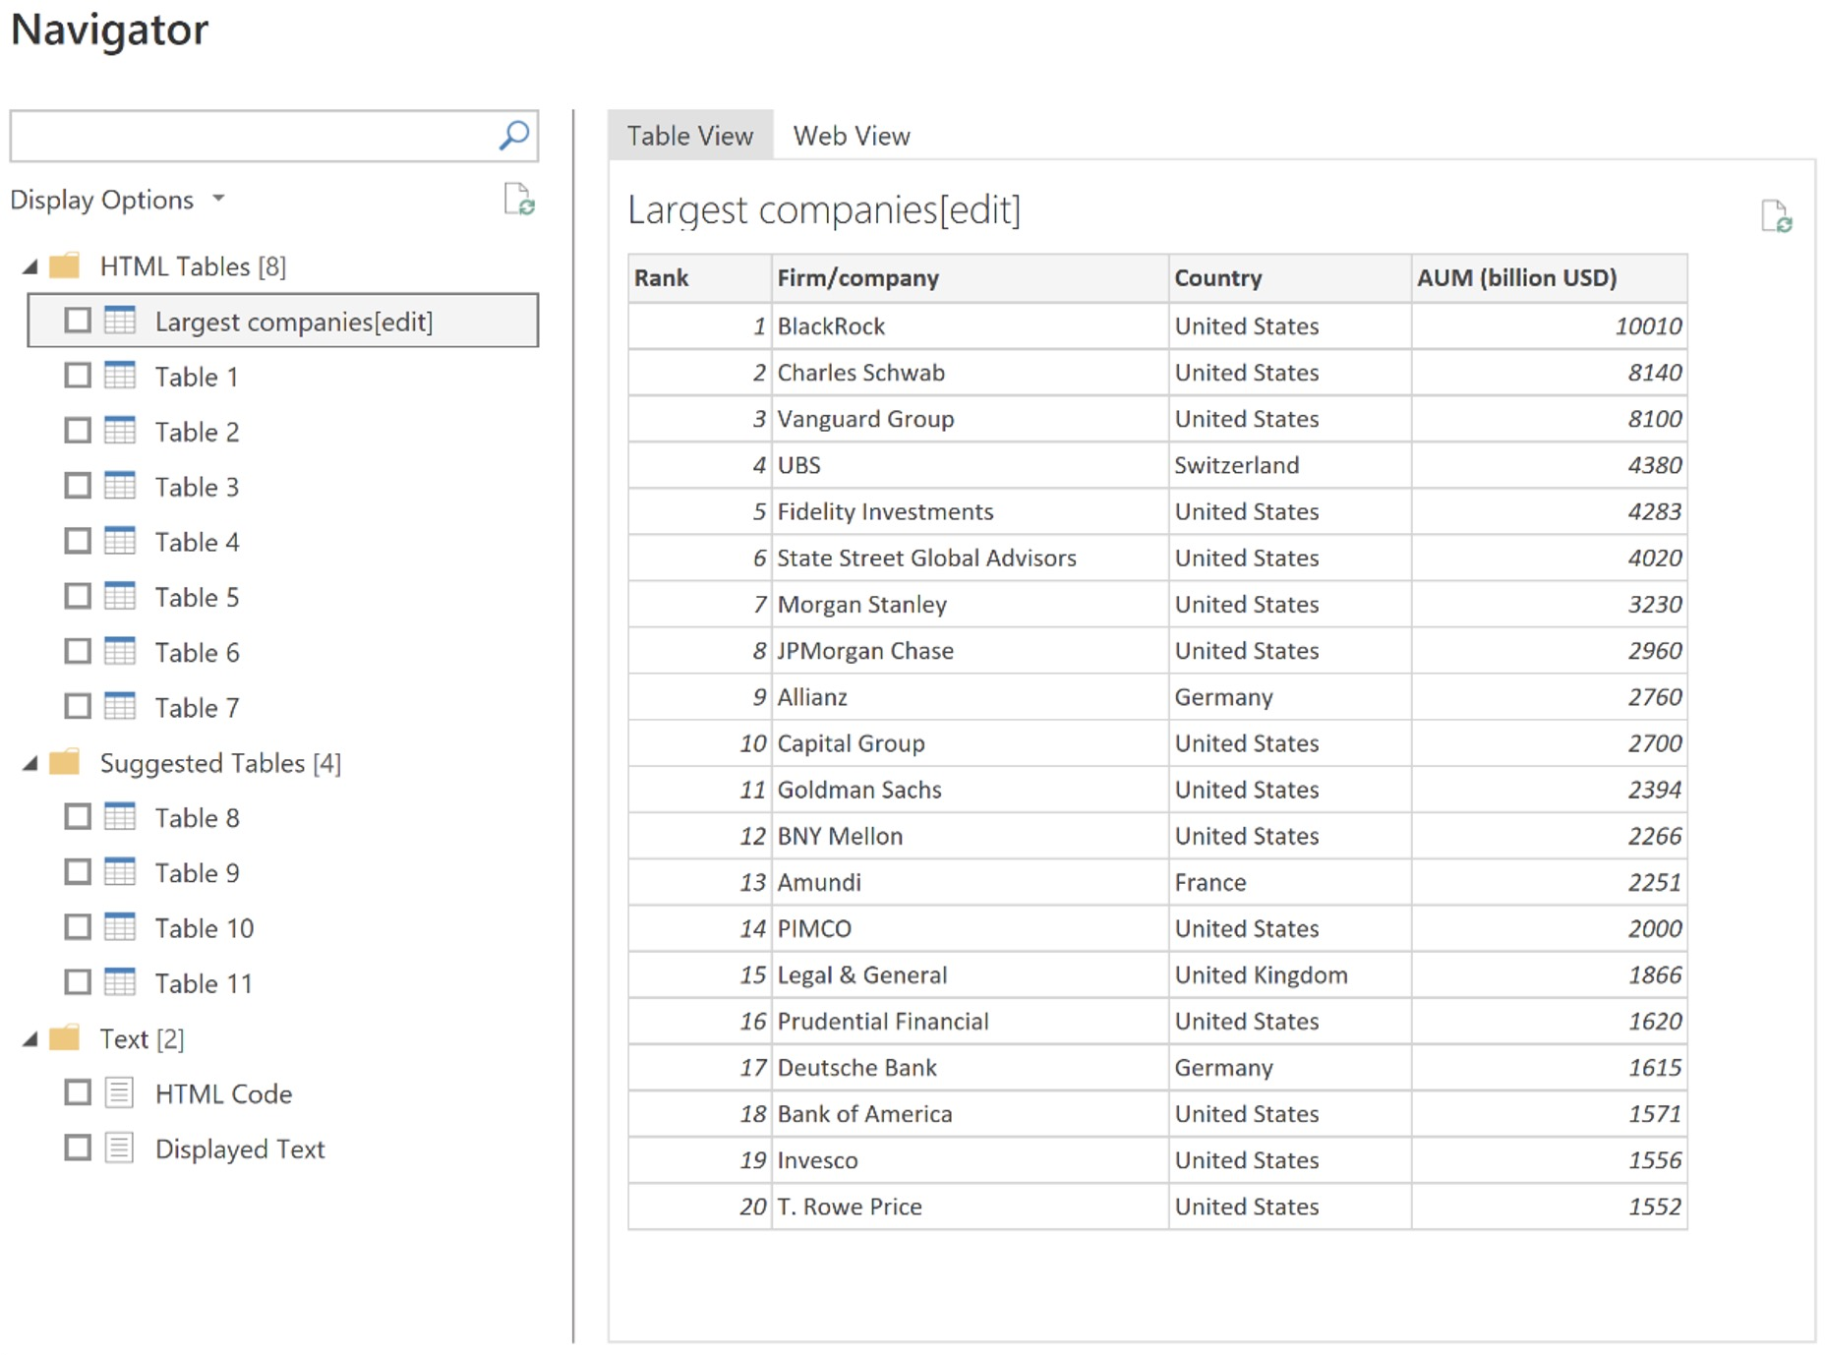
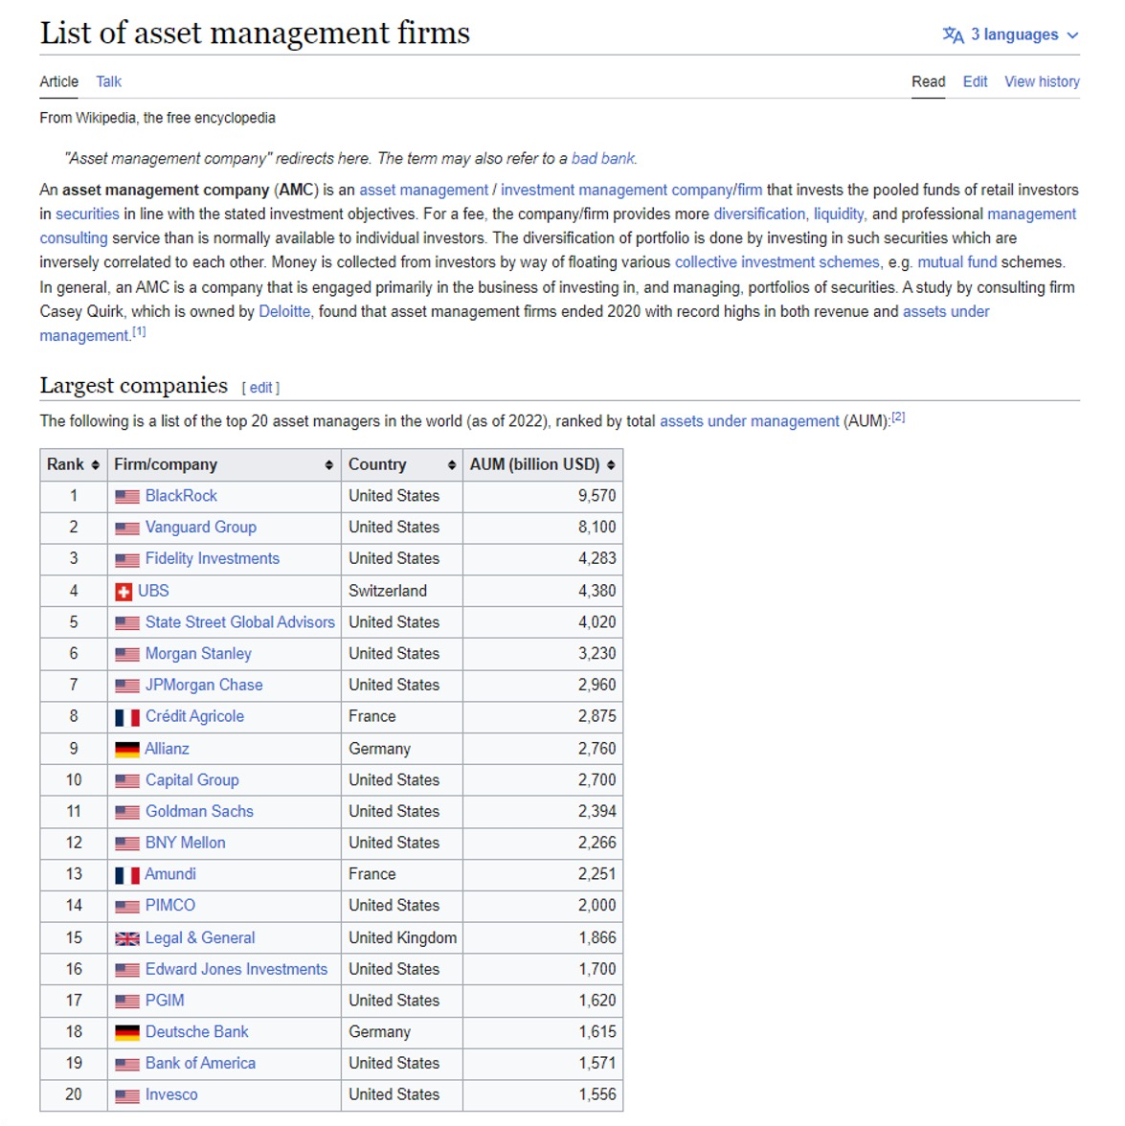
EXTRACTING DATA FROM THE WEB
Power Query includes a native Web connector for importing web-hosted files (csv, xlsx, etc.) or scraping URLs for anything that Power Query can identify as a structured table
https://en.wikipedia.org/wiki/List_of_asset_management_firms

Slide 32

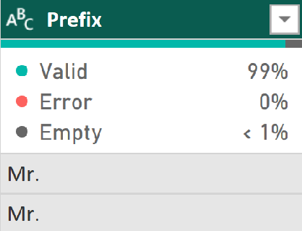
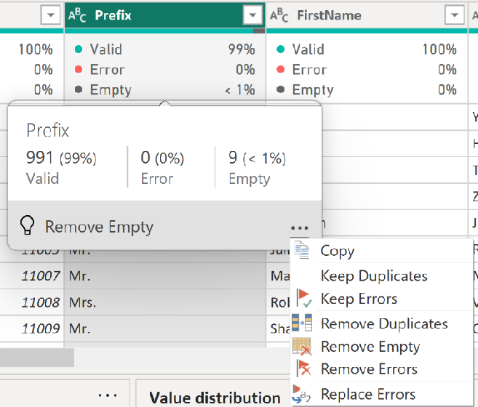





DATA PROFILING: COLUMN QUALITY
Profiling tools like column quality, column distribution, and column profile allow you to explore the quality, composition, and distribution of your data before loading it into the Power BI front-end
Hover over the column quality box to see the number of records in each category
Click the options menu to remove duplicates, errors or empty values
Column quality shows the percentage of values within a column that are valid, contain errors, or are empty
PRO TIP: Profiling tools are a great way to quickly find and address common data quality issues in one place, instead of having to manually apply multiple tools or filters

Slide 33


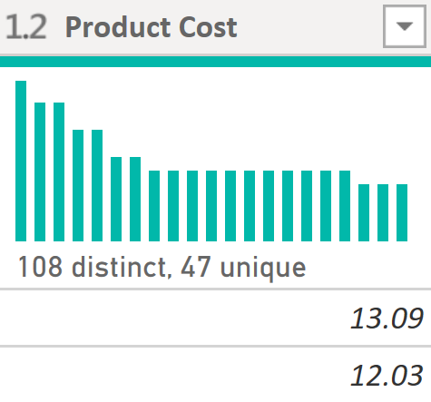
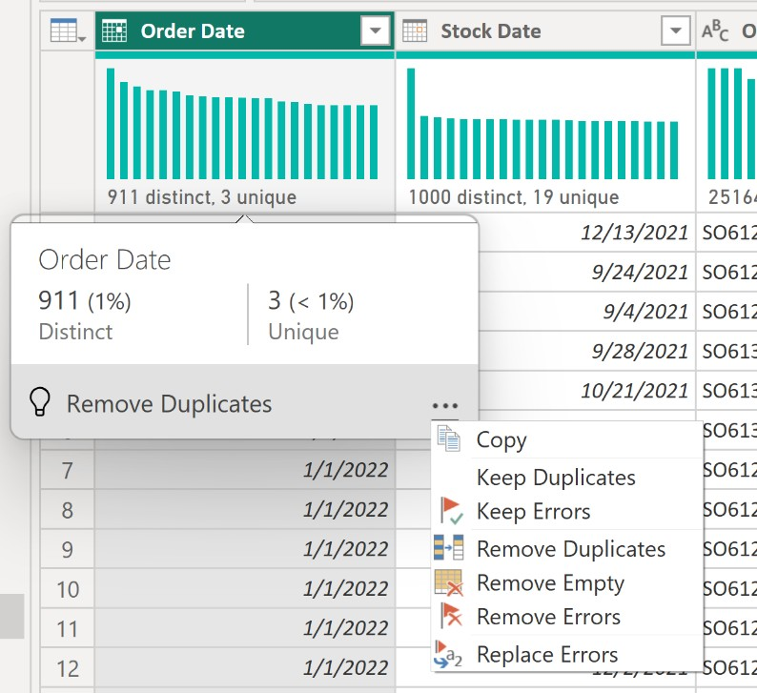




DATA PROFILING: COLUMN DISTRIBUTION
Column distribution provides a sample distribution of the data in a column
Hover over the column quality box to see the number of distinct & unique records
Click the options menu to remove duplicates, errors or empty values
Suggested action based on column distribution results

Slide 34

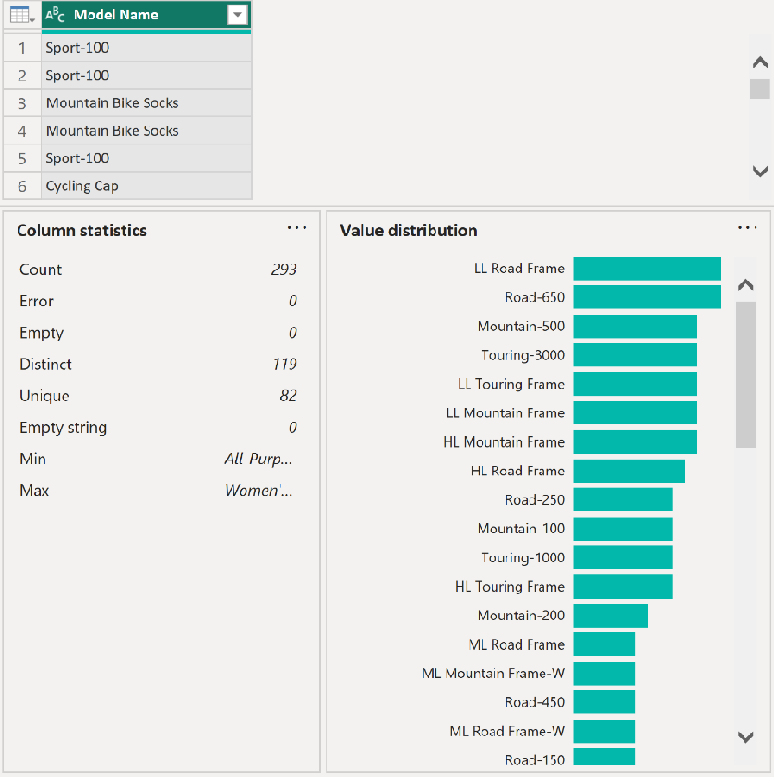




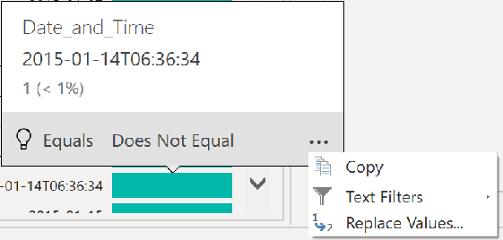
DATA PROFILING: COLUMN PROFILE
Column profile provides a more holistic view of the data in a column, including a sample distribution and profiling statistics
Column statistics provide more detailed profiling metrics, including:
Count = 293
(total number of values in column)
Distinct Count = 119
(total number of distinct values, whether they
appear once or multiple times)
Unique = 82
(total number of values that appear exactly once)
Hover over the value distribution bar for suggested transformations and additional options
Min & Max
(lowest and highest observed values)
Note: Typically only useful for numerical values

Slide 35

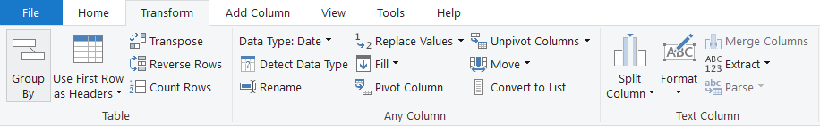
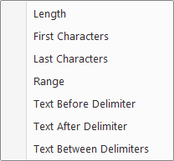

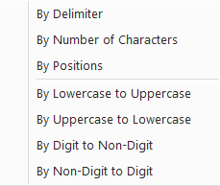

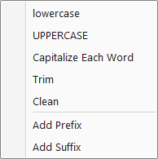
TEXT TOOLS
Split a text column based on a specific delimiter, number of characters, or other attributes
Extract characters from text based on fixed lengths, first/last characters, ranges or delimiters
HEY THIS IS IMPORTANT!
You can access many tools from both the Transform and Add Column menus - the difference is whether you want to ADD a new column or OVERWRITE an existing one
Format a text column to upper, lower or proper case, or add a prefix or suffix
Tip: Use “Trim” to eliminate leading & trailing spaces, or “Clean” to remove non-printable characters

Slide 36
ASSIGNMENT: TEXT TOOLS
NEW MESSAGE
From: Ethan T. Langer (Analytics Manager)
Subject: Customer domains
Key Objectives
Duplicate the email address column and name it “Domain Name”
In the new column, remove all text/characters except for the domain name
Use transformation steps to clean up and capitalize the domain names (i.e. “Adventure Works”)
Save & Apply changes
Hi!
We’re looking to better understand where our customers may be coming from, based on their email domains.
Could you please create a new column in the customer table that will allow us do this?
Thanks!
-ETL

Slide 37

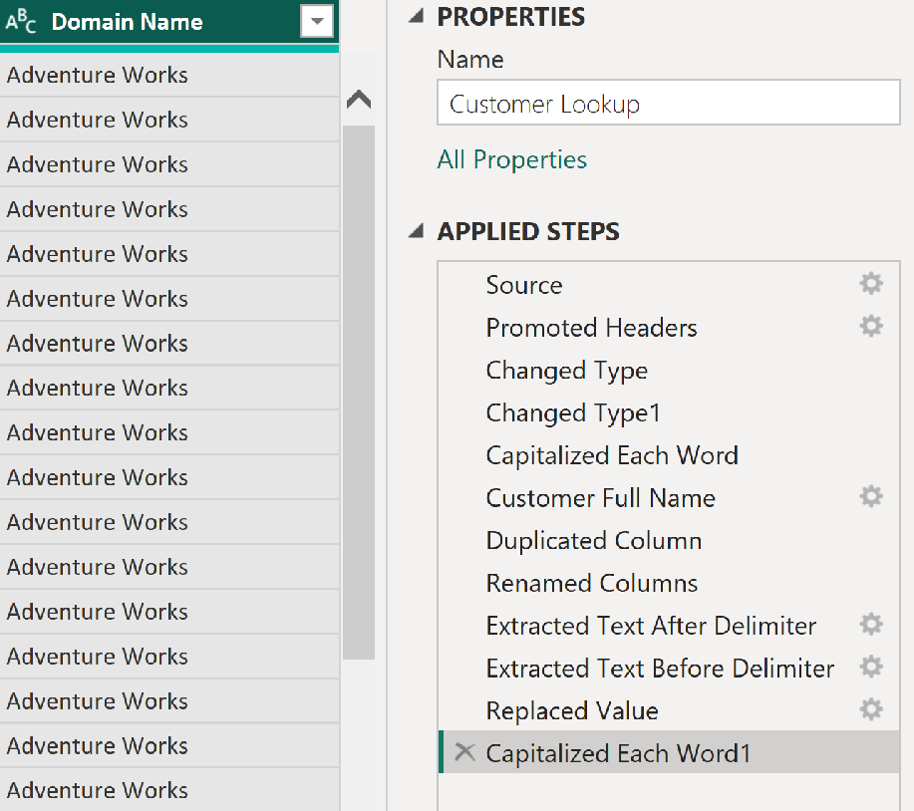
SOLUTION: TEXT TOOLS
NEW MESSAGE
From: Ethan T. Langer (Analytics Manager)
Subject: Customer domains
Solution Preview
Hi!
We’re looking to better understand where our customers may be coming from, based on their email domains.
Could you please create a new column in the customer table that will allow us do this?
Thanks!
-ETL

Slide 38
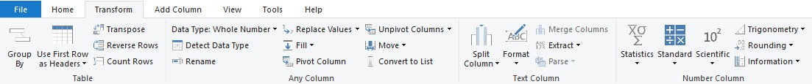








NUMERICAL TOOLS
Information tools allow you to define binary flags (1/0 or TRUE/FALSE) to mark rows as even, odd, positive or negative
Standard Scientific Trigonometry
Standard, Scientific and Trigonometry tools allow you to apply standard operations (addition, multiplication, division, etc.) or more advanced calculations (power, logarithm, sine, tangent, etc.) to each value in a column
Note: Unlike the Statistics tools, these are applied to each row in the table
Statistics functions allow you to evaluate basic stats for a selected column (sum, min/max, average, count, count distinct, etc.)
Note: These tools return a SINGLE value, and are commonly used to explore a table rather than prepare it for loading

Slide 39
ASSIGNMENT: NUMERICAL TOOLS
NEW MESSAGE
From: Ethan T. Langer (Analytics Manager)
Subject: Need some stats for leadership
Key Objectives
What is our average product cost?
How many colors do we sell our products in?
How many distinct customers do we have?
What is the maximum annual customer income?
Return the tables to their original state
Hi again,
Leadership is asking us to validate some high-level stats about our products and customers. Can you please help me answer the following questions?
We don’t really need to store these values anywhere, so make sure to restore the tables back to their original state once you’re done pulling the stats.
Thank you!
-ETL

Slide 40
SOLUTION: NUMERICAL TOOLS
NEW MESSAGE
From: Ethan T. Langer (Analytics Manager)
Subject: Need some stats for leadership
Solution Preview
What is our average product cost? ($413.66)
How many colors do we sell our products in? (10)
How many distinct customers do we have? (18,148)
What is the maximum annual customer income? ($170k)
Return the tables to their original state
Hi again,
Leadership is asking us to validate some high-level stats about our products and customers. Can you please help me answer the following questions?
We don’t really need to store these values anywhere, so make sure to restore the tables back to their original state once you’re done pulling the stats.
Thank you!
-ETL

Slide 41





DATE & TIME TOOLS
Date & Time tools are relatively straight-forward, and include the following options:
Age: Difference between the current date and the date in each row
Date Only: Removes the time component from a date/time field
Year/Month/Quarter/Week/Day: Extracts individual components from a date field (time- specific options include Hour, Minute, Second, etc.)
Earliest/Latest: Evaluates the earliest or latest date from a column as a single value (can only be accessed from the “Transform” menu)
Note: You will almost always want to perform these operations from the “Add Column” menu to build out new fields, rather than transforming an individual date/time column
PRO TIP: Load up a table containing a single date column and use Date tools to build out an entire calendar table

Slide 42








CREATING A CALENDAR TABLE
Use the Date options in the Add Column menu to quickly build out an entire calendar table from a list of dates

Slide 43











CHANGE TYPE WITH LOCALE
1) Left click the data type icon in the column header and select the Using Locale option
2) Select Date as the data type and English (United States) as the locale for all datasets in this course (regardless of your actual location)
3) Confirm that the data type is correctly recognized. You should see a calendar icon 📅 next to the column name in the header and no errors in the column

Slide 44











PRO TIP: ROLLING CALENDARS
1
Create a new blank query & name it “Rolling Calendar”
2
In the formula bar, type a “literal” to generate a start date:
Format as: YYYY, MM, DD
Power Query: New Source > Blank Query
3
Click the ^{𝒇𝒙} icon to add a custom step, and enter the following formula to generate a list of dates between the start date and the current day:
Front end: Get Data > Blank Query
Note: If your first applied step is named something other than “Source”, use that name in your formula (this is common for non-US users)

Slide 45













PRO TIP: ROLLING CALENDARS
4
Convert the resulting list into a Table
and set the data type as a Date
5
Rename the column to “Date” and add calculated date columns (year, month, quarter, etc.) using the Add Column tools

Slide 46
ASSIGNMENT: CALENDAR TABLES
NEW MESSAGE
From: Ethan T. Langer (Analytics Manager)
Subject: New date fields
Key Objectives
Add the following columns to the calendar table:
Month Name (e.g. “January”)
Month Number (e.g. “1”)
3. Start of Year (e.g. “1/1/2020”)
4. Year (e.g. “2020”)
Hi,
We need to add a few fields to our calendar table to help us analyze sales trending over time.
Could you please add the following columns when you get a chance?
Thanks!
-ETL

Slide 47


SOLUTION: CALENDAR TABLES
NEW MESSAGE
From: Ethan T. Langer (Analytics Manager)
Subject: New date fields
Solution Preview
Hi,
We need to add a few fields to our calendar table to help us analyze sales trending over time.
Could you please add the following columns when you get a chance?
Thanks!
-ETL

Slide 48





INDEX COLUMNS
Index Columns contain a list of sequential values that can be used to identify each unique row in a table (typically starting from 0 or 1)
These are often used to create unique IDs that can be used to form relationships between tables (more on that later!)

Slide 49




CONDITIONAL COLUMNS
Conditional Columns allow you to define new fields based on logical rules and conditions (IF/THEN statements)
Here we’re creating a conditional column named Quantity Type, which is based on Order Quantity:
If Order Quantity =1, Quantity Type = “Single Item”
Else If Order Quantity >1, Quantity Type = “Multiple Items”
Else; Quantity Type = “Other”

Slide 50









CALCULATED COLUMN BEST PRACTICES
As a best practice, table transformations and column calculations should ideally happen as close to the original data source as possible, to optimize performance and speed
Data Source
Power Query
Power BI Front-End
Published Reports
UPSTREAM
DOWNSTREAM
HEY THIS IS IMPORTANT!
This is not a strict rule or requirement but can significantly impact performance for very large or complex data models. Where you define calculations often depends on several factors (accessibility, complexity, business requirements, etc.), so we will practice creating columns using both Power Query and the Power BI front-end (DAX) throughout this course

Slide 51










GROUPING & AGGREGATING
Group By allows you to aggregate data at a different level or “grain”
(i.e. group daily records into monthly, aggregate transactions by store, etc.)
Here we’re transforming a daily, transaction-level table into a summary of Total Quantity by Product Key
NOTE: Any fields not specified in the Group By settings are lost

Slide 52







GROUPING & AGGREGATING
This time we’re transforming the daily, transaction-level table into a summary of Total Quantity grouped by both Product Key and Customer Key (using the “Advanced” option)
NOTE: This is like creating a PivotTable in Excel and pulling in Sum of Order Quantity with
Product Key and Customer Key as row labels

Slide 53






PIVOTING & UNPIVOTING
Pivoting describes the process of turning distinct row values into columns, and unpivoting describes the process of turning distinct columns into rows
Imagine the table on a hinge; pivoting rotates it from vertical to horizontal, and unpivoting rotates it from horizontal to vertical
NOTE: Transpose works very similarly, but doesn’t recognize unique values; instead, the entire table is transformed so that each row becomes a column and vice versa

Slide 54



MERGING QUERIES
Merging queries allows you to join tables based on a common column (like a lookup in Excel)
In this case we’re merging the Sales Data table with the Product Lookup table, which share a common Product Key column
NOTE: Merging adds columns to an existing table/query
HEY THIS IS IMPORTANT!
Just because you can merge tables, doesn’t mean you should!
In many cases, it’s better to keep tables separate and define relationships between them in the data model (more on that soon!)

Slide 55







APPENDING QUERIES
Appending queries allows you to combine or stack tables sharing the exact same column structure and data types
Here we’re appending the AdventureWorks Sales 2020 table to the AdventureWorks Sales 2021 table, which is valid since they share identical table structures
NOTE: Appending adds rows to an existing table/query
PRO TIP: Use the Folder option (Get Data > More > Folder) to append all files within a specified folder (assuming they share the same structure); as you add new files, simply refresh the query and they will automatically append!

Slide 56












PRO TIP: APPENDING FILES FROM A FOLDER

Slide 57







DATA SOURCE SETTINGS
Data Source Settings allow you to manage existing data connections, file paths and permissions
HEY THIS IS IMPORTANT!
Connections to local files reference the exact file path, so if the file name or location changes you will need to update your data source settings

Slide 58







PRO TIP: DATA SOURCE PARAMETERS
Use parameters to dynamically manage and update connection paths in the Power Query editor
Parameter name
(Name of the query/table)
Parameter type
(Any value, text, date, etc.)
Parameter value
(Any value, list, query)
Update Server & Database connection text values with parameters
Parameter type
(Default & current)

Slide 59






REFRESHING QUERIES
By default, all queries will refresh when you use the
Refresh command from the Home tab
From the Query Editor, uncheck Include in report refresh
to exclude individual queries from the refresh
PRO TIP: Exclude queries from refresh that don’t change often (like lookups or static data tables)

Slide 60



PRO TIP: IMPORTING EXCEL MODELS
Already have a fully-built model in Excel?
You can import models built in Excel directly into Power BI Desktop using: Import > Power Query, Power Pivot, Power View
Imported models retain the following:
Data source connections and queries
Query editing procedures and applied steps
Table relationships, hierarchies, field settings, etc.
All calculated columns and DAX measures
PRO TIP: If you are more comfortable working in Excel, build your models there first then import to Power BI!
*In older versions of Power BI, this import option may be called “Excel Workbook Contents”

Slide 61


POWER QUERY BEST PRACTICES
Get organized before connecting and loading data
Define clear and intuitive table/query names from the start, and establish an organized file/folder structure if you are working with local flat files to avoid changes to file names or paths
Disable report refresh for any static data sources
There’s no need to constantly refresh data sources that don’t change, like lookups or static data tables
When working with large tables, only load the data you need
Don’t include hourly data when you only need daily, or transaction-level data when only need a product-level summary (extra data will only slow your report down!)

Slide 62
CREATING A DATA MODEL

Slide 63






CREATING A DATA MODEL
In this section we’ll cover foundational data modeling topics like normalization, fact and dimension tables, primary and foreign keys, relationship cardinality and filter flow
TOPICS WE’LL COVER:
GOALS FOR THIS SECTION:
Understand the basic principles of data modeling, including normalization, fact & dimension tables and common schemas
Data Modeling 101
Normalization
Create table relationships using primary and foreign keys, and discuss different types of relationship cardinality
Facts & Dimensions
Primary & Foreign Keys
Configure report filters and trace filter context as it flows between related tables in the model
Cardinality
Filter Flow
Explore data modeling options like hierarchies, data categories and hidden fields
Common Schemas
Hierarchies

Slide 64







WHAT IS A DATA MODEL?
This IS NOT a data model
This is a collection of independent tables, which share no connections or relationships
If you tried to visualize Orders and Returns
by Product, this is what you’d get

Slide 65






WHAT IS A DATA MODEL?
This IS a data model!
The tables are connected via relationships, based on a common field (Product Key)
Now Sales and Returns data can be filtered using fields from the Product Lookup table!

Slide 66






DATABASE NORMALIZATION
Normalization is the process of organizing the tables and columns in a relational database to reduce redundancy and preserve data integrity. It’s commonly used to:
Eliminate redundant data to decrease table sizes and improve processing speed & efficiency
Minimize errors and anomalies from data modifications (inserting, updating or deleting records)
Simplify queries and structure the database for meaningful analysis
In a normalized database, each table should serve a distinct and specific purpose (i.e. product information, transaction records, customer attributes, store details, etc.)
Models that aren’t normalized contain redundant, duplicate data. In this case, all of the product-specific fields could be stored in a separate table containing a unique record for each product id
This may not seem critical now, but minor inefficiencies can become major problems at scale!

Slide 67







FACT & DIMENSION TABLES
Data models generally contain two types of tables: fact (“data”) tables, and dimension (“lookup”) tables:
Fact tables contain numerical values or metrics used for summarization (sales, orders, transactions, pageviews, etc.)
Dimension tables contain descriptive attributes used for filtering or grouping (products, customers, dates, stores, etc.)
This Calendar Lookup table contains attributes about each date (month, year, quarter, etc.)
This Product Lookup table contains attributes about each product_id (brand, SKU, price, etc.)
This Fact table contains quantity values, along with date and product_id fields

Slide 68




PRIMARY & FOREIGN KEYS
Fact Table
Calendar Lookup
Product Lookup
These are foreign keys (FK)
They contain multiple instances of each value, and relate to primary keys in dimension tables
These are primary keys (PK)
They uniquely identify each row of the table, and relate to foreign keys in fact tables

Slide 69


RELATIONSHIPS VS. MERGED TABLES
Can’t I just merge queries or use lookup functions to pull everything into one single table?
- Anonymous confused man
Original Fact Table fields
Attributes from Calendar Lookup table
Attributes from Product Lookup table
You can, but it’s extremely inefficient!
Merging tables creates redundancy and often requires significantly more memory and processing power to analyze compared to a relational model with multiple small tables

Slide 70







THE MODEL VIEW
Menu Ribbon
(Home, Help)
Data / Field List
Model canvas
Model layout tabs
Properties pane
(Name, synonym, format, etc.)
View Options
(Zoom, Reset Layout, Fit to Page)

Slide 71








CREATING TABLE RELATIONSHIPS
OPTION 1: Click and drag to connect primary and foreign keys within the Model view
OPTION 2: Add or detect relationships using the Manage Relationships dialog box

Slide 72




MANAGING & EDITING RELATIONSHIPS
Launch the Manage Relationships dialog box or double-click a relationship to modify it
Editing tools allow you to activate or deactivate relationships and manage cardinality and filter direction – more on that soon!

Slide 73










STAR & SNOWFLAKE SCHEMAS
A star schema is the simplest and most common type of data model, characterized by a single fact table surrounded by related dimension tables
A snowflake schema is an extension of a star, and includes relationships between dimension tables and related sub-dimension tables

Slide 74

ASSIGNMENT: TABLE RELATIONSHIPS
NEW MESSAGE
From: Dana Modelle (Analyst)
Subject: Need a favor…
Key Objectives
Delete all existing table relationships
Create a star schema by creating relationships between the Sales, Calendar, Customer, Product and Territories tables
Connect all three product tables (Product, Subcategory, Category) in a snowflake schema
Use the matrix visual to confirm that you can filter Order Quantity values using fields from each dimension table
Hey there,
Ethan shared the data model you’ve been working on, and we might have an issue…
Last night I left my laptop open, and my cat Dennis somehow got his paws on our model. Now all the relationships are gone!
Could you please rebuild the model, including all three product tables? I owe you one!
-Dana

Slide 75


SOLUTION: TABLE RELATIONSHIPS
NEW MESSAGE
From: Dana Modelle (Analyst)
Subject: Need a favor…
Solution Preview
Hey there,
Ethan shared the data model you’ve been working on, and we might have an issue…
Last night I left my laptop open, and my cat Dennis somehow got his paws on our model. Now all the relationships are gone!
Could you please rebuild the model, including all three product tables? I owe you one!
-Dana

Slide 76








PRO TIP: ACTIVE & INACTIVE RELATIONSHIPS
The Sales Data table contains two date fields (Order Date & Stock Date), but there can only be one active relationship to the Date key in the Calendar table
You can set relationships to active or inactive from either the Edit Relationships
dialog box or the Properties (you must deactivate one before activating another)

Slide 77






PRO TIP: ACTIVE & INACTIVE RELATIONSHIPS
The Sales Data table contains two date fields (Order Date & Stock Date), but there can only be one active relationship to the Date key in the Calendar table
You can set relationships to active or inactive from either the Edit Relationships
dialog box or the Properties (you must deactivate one before activating another)

Slide 78




RELATIONSHIP CARDINALITY
Cardinality refers to the uniqueness of values in a column
Ideally, all relationships in the data model should follow a one-to-many cardinality: one instance of each primary key, and many instances of each foreign key
In this example there is only ONE instance of each Product Key in the Product table (noted by a “1”), since each row contains attributes of a single product (name, SKU, description, price, etc.)
There are MANY instances of each Product Key in the Sales table (noted by an asterisk *), since there are multiple sales for each product

Slide 79






EXAMPLE: ONE-TO-ONE CARDINALITY
Product Lookup
Price Lookup
Connecting the two tables above using product_id creates a one-to-one relationship, since each product ID only appears once in each table
This isn’t necessarily a “bad” relationship, but you can simplify the model by merging the tables into a single, valid dimension table
NOTE: this still respects the rules of normalization, since all rows are unique and capture product-specific attributes

Slide 80







EXAMPLE: MANY-TO-MANY CARDINALITY
Product Lookup
Sales
If we try to connect the tables above using product_id, we’ll get a many-to-many relationship
warning since there are multiple instances of product_id in both tables
Even if we force this relationship, how would we know which product was actually sold on each date – Cream Soda or Diet Cream Soda?

Slide 81



CONNECTING MULTIPLE FACT TABLES
This model contains two fact tables: Sales Data and
Returns Data
Since there is no primary/foreign key relationship, we can’t connect them directly to each other
But we can connect each fact table to related lookups, which allows us to filter both sales and returns data using fields from any shared lookup tables
We can view orders and returns by product since both tables relate to Product Lookup, but we can’t view returns by customer since no relationship exists
HEY THIS IS IMPORTANT!
Generally speaking, fact tables should connect through shared dimension tables, not directly to each other

Slide 82




FILTER CONTEXT & FLOW
Here we have two data tables (Sales Data and Returns Data), connected to Territory Lookup
The arrows show the filter direction, and point from the one (1) side of the relationship to the many (*) side
When you filter a table, that filter context is passed to any related “downstream” tables, following the arrow’s direction
Filter context CANNOT flow “upstream”
PRO TIP: Arrange lookup tables above fact tables in your model as a visual reminder that filters always flow downstream

Slide 83


















EXAMPLE: FILTER FLOW
In this model, the only way to filter both Sales and Returns data by Territory is to use the Territory Key from the lookup table, which is upstream and related to both fact tables
Filtering using Territory Key from the Sales table yields incorrect Returns values, since the filter context can’t flow to any other table
Filtering using Territory Key from the Returns table yields incorrect Sales values, and is limited to territories that exist in the returns table
Filtering by Returns Data[Territory Key]
Filtering by Territory Lookup[Territory Key]
Filtering by Sales Data[Territory Key]

Slide 84





BI-DIRECTIONAL FILTERS
Updating the cross-filter direction from Single to Both allows filter context to flow in either direction
In this example, filters applied to the Sales table can pass up to the Territory Lookup table, then down to Returns
*The “Apply security filter in both directions” option relates to row-level security (RLS) settings, which are out of scope for this course

Slide 85












EXAMPLE: BI-DIRECTIONAL FILTERS
With two-way cross-filtering enabled between Sales and Territory, we now see correct values using Territory Key from either table
Filter context can now pass up to the Territory Lookup table, then downstream to Returns
However, we still see incorrect values when filtering using Territory Key from the Returns table, since the filter context is isolated to that single table
Filtering by Returns Data[Territory Key]
Filtering by Territory Lookup[Territory Key]
Filtering by Sales Data[Territory Key]

Slide 86














EXAMPLE: BI-DIRECTIONAL FILTERS
In this case, we’ve enabled two-way cross-filtering between the
Returns and Territory tables
As expected, we now see incorrect values when filtering using Territory Key from the Sales table, since the filter context is isolated to that single table
While the values appear to be correct when filtering using Territory Key from the Returns table, we’re missing sales data from any territories that didn’t appear in the returns table (specifically Territories 2 & 3)
Territories 2 & 3 don’t exist in the Returns table, so they aren’t included in the filter context that passes to Territory Lookup and Sales
Filtering by Returns Data[Territory Key]
Filtering by Territory Lookup[Territory Key]
Filtering by Sales Data[Territory Key]

Slide 87




AMBIGUITY
Use two-way filters carefully, and only when necessary
Using multiple two-way filters can cause ambiguity by introducing multiple filter paths between tables
In this example, filter context from the Product table can pass down to Returns and up to Territory Lookup, which would be filtered based on the Territory Keys passed from the Returns table
With an active relationship between Product and Sales as well, filter context could pass through either the Sales or Returns table to reach the Territory Lookup table, which could yield conflicting filter context
PRO TIP: Design your models with one-way filters and 1:many cardinality unless more complex relationships are absolutely necessary

Slide 88





HIDING FIELDS
Hide in Report View makes fields inaccessible from the Report tab, but still available in Data and Model views
This can be controlled by right-clicking a field in the Data or Model view, or by selecting “Is hidden” in the Properties pane
This is commonly used to prevent users from filtering using invalid fields, reduce clutter, or to hide irrelevant metrics from view
PRO TIP: Hide the foreign keys in fact tables to force users to filter using primary keys in dimension tables

Slide 89

ASSIGNMENT: FILTER FLOW
NEW MESSAGE
From: Dana Modelle (Analyst)
Subject: Larry’s gone rogue!
Key Objectives
1. Replicate Larry’s matrix below to diagnose what he must have done to the model*
Hey there, we’ve got another problem.
Larry from Sales just sent me this screenshot. I think he must have downloaded our Power BI model and messed with some relationships, because I KNOW we had sales for product 338.
Can you help diagnose what’s going on, and prevent him from doing this again?
-Dana
P.S. Kevin says hi
Which product is #338?
Why didn’t Larry’s matrix show any orders?
2. Hide any remaining foreign keys to prevent other users from making the same mistake
*Hint: you may need to temporarily change a relationship to bi-directional

Slide 90

SOLUTION: FILTER FLOW
NEW MESSAGE
From: Dana Modelle (Analyst)
Subject: Larry’s gone rogue!
Solution Preview
Larry must have changed the relationship between Returns Data and Product Lookup to bi-directional, and filtered his matrix using product_id from the Returns table
Road bike (Road-650 Black, 44)
Product 338 doesn’t exist in the Returns table, so it was excluded when that filter context passed to the Sales table
Hey there, we’ve got another problem.
Larry from Sales just sent me this screenshot. I think he must have downloaded our Power BI model and messed with some relationships, because I KNOW we had sales for product 338.
Can you help diagnose what’s going on, and prevent him from doing this again?
-Dana
P.S. Kevin says hi
2.

Slide 91







PRO TIP: MODEL LAYOUTS
Model layouts allow you to create custom views to show specific portions of large, complex models
Here we’ve created a Sales View displaying only tables related to sales, and a Returns View displaying only tables related to returns (Note: this doesn’t actually create duplicate tables)

Slide 92




DATA FORMATS & CATEGORIES
Customize data formats from the Column tools menu in the
Data view or the Properties pane in the Model view
Assign data categories for geospatial fields, URLs or barcodes
This is commonly used to help Power BI map location-based fields like addresses, countries, cities, coordinates, zip codes, etc.

Slide 93







HIERARCHIES
Hierarchies are groups of columns that reflect multiple levels of granularity
For example, a Geography hierarchy might include Country, State and City fields
Hierarchies are treated as a single item in tables and reports, allowing users to “drill up” and “drill down” through each level
In the Data pane, right-click a field and select Create hierarchy
This hierarchy contains “Continent”, and is named “Territory Hierarchy”
Right-click another field (like “Country”) and select Add to Hierarchy (or drag it in!)

Slide 94
ASSIGNMENT: HIERARCHIES
NEW MESSAGE
From: Dana Modelle (Analyst)
Subject: Adding a date hierarchy
Key Objectives
Create a new hierarchy based on the Start of Year field, and name it “Date Hierarchy”
Right-click or drag to add fields until your hierarchy contains the following (in this order):
Start of Year
Start of Month
Start of Week
Date
Add your new hierarchy to the matrix visual (on rows) and practice drilling up and down between each level of granularity
Good morning!
Hoping you can help with a quick request.
Since we’ll be doing a lot of time-series analysis, Ethan asked us to add a date hierarchy to the model so that users can quickly view trends at any level of granularity (year, month, day, etc.)
Please get that added before our afternoon call. Thanks!
-Dana

Slide 95


SOLUTION: HIERARCHIES
NEW MESSAGE
From: Dana Modelle (Analyst)
Subject: Adding a date hierarchy
Solution Preview
Good morning!
Hoping you can help with a quick request.
Since we’ll be doing a lot of time-series analysis, Ethan asked us to add a date hierarchy to the model so that users can quickly view trends at any level of granularity (year, month, day, etc.)
Please get that added before our afternoon call. Thanks!
-Dana

Slide 96



DATA MODEL BEST PRACTICES
Focus on building a normalized model from the start
Leverage relationships and make sure that each table serves a clear, distinct purpose
Organize dimension tables above data tables in your model
This serves as a visual reminder that filters always flow “downstream”
Avoid complex relationships unless absolutely necessary
Aim to use 1-to-many table relationships and one-way filters whenever possible
Hide fields from report view to prevent invalid filter context
This forces report users to filter using primary keys from dimension tables

Slide 97
CALCULATED FIELDS WITH DAX

Slide 98






CALCULATED FIELDS WITH DAX
In this section we’ll use Data Analysis Expressions (DAX) to add calculated columns & measures to our model, and introduce topics like row & filter context, iterators and more
TOPICS WE’LL COVER:
DAX 101 Columns & Measures
GOALS FOR THIS SECTION:
Introduce DAX fundamentals and learn when to use calculated columns and measures
Understand the difference between row context and filter context, and how they impact DAX calculations
Row & Filter Context
DAX Syntax
Learn DAX formula syntax, basic operators and common function categories (math, logical, text, date/time, filter, etc.)
Common Functions
Calculate
Explore nested functions, and more complex topics like iterators and time intelligence patterns
Iterators
Time Intelligence

Slide 99










MEET DAX
Data Analysis Expressions (commonly known as DAX) is the formula language that drives the Power BI front-end. With DAX, you can:
Go beyond the capabilities of traditional spreadsheet formulas, with powerful and flexible functions built specifically to work with relational data models
Add calculated columns (for filtering) and measures (for aggregation) to enhance data models
Two ways to use DAX
Calculated Columns
Measures

Slide 100








M VS. DAX
M and DAX are two distinct functional languages used within Power BI Desktop:
M is used in the Power Query editor, and is designed specifically for extracting, transforming and loading data
DAX is used in the Power BI front-end, and is designed specifically for analyzing relational data models
M DAX
Query Editor: Report View:

Slide 101

CALCULATED COLUMNS
Calculated columns allow you to add new, formula-based columns to tables in a model
Calculated columns refer to entire tables or columns (no A1-style cell references)
Calculated columns generate values for each row, which are visible within tables in the Data view
Calculated columns understand row context; they’re great for defining properties based on information in each row, but generally useless for aggregation (sum, count, etc.)
HEY THIS IS IMPORTANT!
As a rule of thumb, use calculated columns to “stamp” static, fixed values to each row in a table (or go upstream and use the Query Editor!)
DO NOT use calculated columns for aggregation – this is what measures are for!
PRO TIP:
Calculated columns are typically used for filtering & grouping data, rather than creating aggregate numerical values

Slide 102







EXAMPLE: CALCULATED COLUMNS
In this case we’ve added a calculated column named Parent, which equals “Yes” if the [Total Children] field is greater than 0, and “No” otherwise
Since calculated columns understand row context, a new value is calculated in each row based on the value in the [Total Children] column
This is a valid use of calculated columns; it creates a new row “property” that we can use to filter or segment any related data within the model
Here we’re using an aggregation function (SUM) to calculate a new column named TotalQuantity
Since this is an aggregation function, the same grand total is returned in every row of the table
This is not a valid use of calculated columns; these values are statically “stamped” onto the table and can’t be filtered, sliced, etc.

Slide 103
DAX MEASURES
Measures are DAX formulas used to generate new calculated values
Like calculated columns, measures reference entire tables or
columns (no A1-style cell references)
Unlike calculated columns, measures aren’t visible within tables; they can only be “seen” within a visualization like a chart or matrix (similar to a calculated field in a PivotTable)
Measures evaluate based on filter context, which means they recalculate when the fields or filters around them change
HEY THIS IS IMPORTANT!
As a rule of thumb, use measures when a single row can’t give you the answer, or when you need to aggregate values across multiple rows in a table
PRO TIP:
Use measures to create numerical, calculated values that can be analyzed in the “values” field of a report visual

Slide 104

IMPLICIT VS. EXPLICIT MEASURES
Implicit measures are created when you drag raw numerical fields into a report visual and manually select an aggregation mode (Sum, Average, Min, Max, Count, etc.)
Explicit measures are created when you actually write a DAX formula and define a new measure that can be used within the model
HEY THIS IS IMPORTANT!
Implicit measures are only accessible within the specific visualization
in which they were created, and cannot be referenced elsewhere
Explicit measures can be used anywhere in the report, and referenced by other DAX calculations to create “measure trees”
Example of an implicit measure

Slide 105





QUICK MEASURES
Quick measures automatically create formulas based on pre-built templates or natural language prompts
Quick measure calculations can be used to build measures using predefined templates (weighted averages, percent difference, time intelligence, etc.)
Quick measure suggestions can be used to find suggested measures based on natural language queries (i.e. “sum of quantity sold by calendar year”)
PRO TIP:
Quick measures can be a great learning tool for beginners or for building more complex formulas but use
them with caution; mastering DAX requires a deep understanding of the underlying theory!

Slide 106









RECAP: CALCULATED COLUMNS VS. MEASURES
CALCULATED COLUMNS
MEASURES
Values are calculated based on information from each row of a table (row context)
Appends static values to each row in a table and stores them in the model (which increases file size)
Recalculate on data source refresh or when changes are made to component columns
Primarily used for filtering data in reports
Values are calculated based on information from any filters in the report (filter context)
Does not create new data in the tables themselves (doesn’t increase file size)
Recalculate in response to any change to filters within the report
Primarily used for aggregating values in report visuals
Calculated columns “live” in tables
Measures “live” in visuals

Slide 107









PRO TIP: MEASURE TABLES
It’s a common best practice to create a dedicated table to store your measures; this will help you stay organized, find measures quickly, and allow you to group related measures into folders
Option 1: Enter Data into Power Query (loads the table to the data model – table is visible in Power Query)
Add a table Name and click OK to load the table to the data model
*from the Report view
Option 2: Create a calculated table using DAX directly in the model (table is not visible in Power Query)
Create new table & use a table constructor { } to add a single column
*from the Data view

Slide 108









FILTER CONTEXT
Measures are evaluated based on filter context, which means that they recalculate whenever the fields or filters around them change
For this value in the matrix (2,846), the Orders measure is calculated based on the following filter context: Products[Product Name] = “Mountain Tire Tube”
This allows the measure to return the total order quantity for each product specifically (or whatever context the row and column labels dictate – years, countries, categories, customer names, etc.)
This total (15,587) does NOT calculate by summing the values above; it evaluates as an independent measure with no filter context applied
IMPORTANT: Every measure value in a report evaluates independently (like an island) and calculates based on its own filter context
PRO TIP: Clicking the filter icon will show you the filters currently applied to a selected visual

Slide 109









EXAMPLE: FILTER CONTEXT
MEASURE: Revenue Per Customer FILTER CONTEXT:
Calendar[Year] = 2021 or 2022
MEASURE: Total Customers FILTER CONTEXT:
Calendar[Date] = September 26, 2021
This is a page-level filter, which impacts ALL visuals on this report page (more on this later!)
COLUMN: Customer Full Name FILTER CONTEXT:
Calendar[Year] = 2021 or
2022
Customer[Full Name] = Top 1
by Total Revenue
MEASURE: Total Orders FILTER CONTEXT:
Calendar[Year] = 2021 or 2022
Customers[Occupation] = Skilled Manual
MEASURE: Total Revenue FILTER CONTEXT:
Calendar[Year] = 2021 or 2022
Customer[Full Name] = Top 100 by Total Orders
MEASURE: Total Revenue FILTER CONTEXT:
Calendar[Year] = 2021 or 2022
Customer[Full Name] = Mr. Maurice Shan

Slide 110


















STEP-BY-STEP MEASURE CALCULATION
How exactly is this measure value calculated?
NOTE: This all happens instantly behind the scenes, every time the filter context changes
STEP 1
Filter context is detected & applied
STEP 2
Filters flow “downstream” to related tables
STEP 3
Measure evaluates against the filtered table
Product Lookup Table
Black
’Product Lookup’[Product Color] = “Black”
Product Lookup Table
1 1
Sum of values in the Order Quantity column of the Sales Data table, filtered to rows where the product color is “Black”
⁼ 10,590
Black
*
Sales Data
*
Black
Returns Data
Black

Slide 111
DAX SYNTAX
MEASURE NAME
Referenced
TABLE NAME
Referenced
COLUMN NAME
Measures are always surrounded by brackets (i.e. [Total Quantity]) when referenced in formulas, so spaces are OK
Total Quantity: = SUM(Transactions[quantity])
FUNCTION NAME
This is a “fully qualified” column, since it’s preceded by the table name.
NOTE: Table names with spaces must be surrounded by single quotes:
Without a space: Transactions[quantity]
With a space: ‘Transactions Table’[quantity]
Calculated columns don’t always use functions, but measures do:
In a Calculated Column, =Transactions[quantity] returns the value from the quantity column in each row (since it evaluates one row at a time)
In a Measure, =Transactions[quantity] will return an error since Power BI doesn’t know how to translate that as a single value – you need some sort of aggregation
PRO TIP:
Column references use fully qualified names (i.e. ’Table’[Column])
Measure references just use the measure name (i.e. [Measure]) and can be called by typing an open square bracket “ [ “

Slide 112

DAX OPERATORS
Arithmetic Operator | Meaning | Example
+ | Addition | 2 + 7
- | Subtraction | 5 – 3
* | Multiplication | 2 * 6
/ | Division | 4 / 2
^ | Exponent | 2 ^ 5
Comparison Operator | Meaning | Example
= | Equal to | [City]=“Boston”
> | Greater than | [Quantity]>10
< | Less than | [Quantity]<10
>= | Greater than or equal to | [Unit Price]>=2.5
<= | Less than or equal to | [Unit Price]<=2.5
<> | Not equal to | [Country]<>”Mexico”
Pay attention to these!
Text/Logical Operator |  |  | Meaning | Example
& |  |  | Concatenates two values to produce one text string | [City] & “ “ & [State]
 | && |  | Create an AND condition between two logical expressions | ([State]=“MA”) && ([Quantity]>10)
 | || (double pipe) |  | Create an OR condition between two logical expressions | ([State]=“MA”) || ([State]=“CT”)
IN |  |  | Creates a logical OR condition based on a given list (using curly brackets) | ‘Store Lookup’[State] IN { “MA”, “CT”, “NY” }
*Head to https://learn.microsoft.com for more information about DAX syntax, operators, troubleshooting, etc.

Slide 113




COMMON FUNCTION CATEGORIES
MATH & STATS |  |  | LOGICAL |  |  | TEXT |  |  | FILTER |  |  | TABLE |  |  | DATE & TIME |  |  | RELATIONSHIP
Functions |  |  | Functions |  |  | Functions |  |  | Functions |  |  | Functions |  |  | Functions |  |  | Functions
Functions used for |  |  | Functions that use |  |  | Functions used to |  |  | Functions used to |  |  | Functions that create or |  |  | Functions used to |  |  | Functions used to
aggregation or |  |  | conditional expressions |  |  | manipulate text strings |  |  | manipulate table and |  |  | manipulate tables and |  |  | manipulate date & time |  |  | manage & modify
iterative, row-level calculations |  |  | (IF/THEN statements) |  |  | or value formats |  |  | filter contexts |  |  | output tables vs. scalar values |  |  | values or handle time intelligence calculations |  |  | table relationships
Common Examples: |  |  | Common Examples: |  |  | Common Examples: |  |  | Common Examples: |  |  | Common Examples: |  |  | Common Examples: |  |  | Common Examples:
SUM |  |  | IF |  |  | CONCATENATE |  |  | CALCULATE |  |  | SUMMARIZE |  |  | DATE |  |  | RELATED
AVERAGE |  |  | IFERROR |  |  | COMBINEVALUES |  |  | FILTER |  |  | ADDCOLUMNS |  |  | DATEDIFF |  |  | RELATEDTABLE
MAX/MIN |  |  | AND |  |  | FORMAT |  |  | ALL |  |  | GENERATESERIES |  |  | YEARFRAC |  |  | CROSSFILTER
DIVIDE |  |  | OR |  |  | LEFT/MID/RIGHT |  |  | ALLEXCEPT |  |  | DISTINCT |  |  | YEAR/MONTH |  |  | USERELATIONSHIP
COUNT/COUNTA |  |  | NOT |  |  | UPPER/LOWER |  |  | ALLSELECTED |  |  | VALUES |  |  | DAY/HOUR
COUNTROWS |  |  | SWITCH |  |  | LEN |  |  | KEEPFILTERS |  |  | UNION |  |  | TODAY/NOW
DISTINCTCOUNT Iterator Functions: SUMX AVERAGEX MAXX/MINX RANKX COUNTX |  |  | TRUE FALSE |  |  | SEARCH/FIND REPLACE SUBSTITUTE TRIM |  |  | REMOVEFILTERS SELECTEDVALUE |  |  | INTERSECT TOPN |  |  | WEEKDAY WEEKNUM NETWORKDAYS Time Intelligence: DATESYTD DATESMTD DATEADD DATESBETWEEN
*Note: This is NOT a comprehensive list. DAX contains more than 250 different functions!

Slide 114









BASIC MATH & STATS FUNCTIONS
SUM
Evaluates the sum of a column
=SUM(ColumnName)
AVERAGE
Returns the average (arithmetic mean) of all the numbers in a column
=AVERAGE(ColumnName)
MAX
Returns the largest value in a column or between two scalar expressions
=MAX(ColumnNameOrScalar1, [Scalar2])
MIN
Returns the smallest value in a column or between two scalar expressions
=MIN(ColumnNameOrScalar1, [Scalar2])
DIVIDE
Performs division and returns the alternate result (or blank) if DIV/0
=DIVIDE(Numerator, Denominator, [AlternateResult])

Slide 115







COUNTING FUNCTIONS
COUNT
Counts the number of non-empty cells in a column (excluding Boolean values)
=COUNT(ColumnName)
COUNTA
Counts the number of non-empty cells in a column (including Boolean values)
=COUNTA(ColumnName)
DISTINCTCOUNT
Counts the number of distinct values in a column
=DISTINCTCOUNT(ColumnName)
COUNTROWS
Counts the number of rows in the specified table, or a table defined by an expression
=COUNTROWS([Table])

Slide 116

ASSIGNMENT: MATH & STATS
NEW MESSAGE
From: Dianne A. Xu (Senior Analyst)
Subject: Help with a few measures
Key Objectives
Create a measure named Total Customers, to calculate the number of distinct AdventureWorks customers who made a transaction
Create a measure named Return Rate, defined as quantity returned divided by quantity sold
Hey there, excited to start working with you!
I’ll need to pull some high-level metrics from our model to share with leadership, and I could use some help with the calculations.
For now, could you please create one measure to calculate the total number of distinct customers, and a second measure that we can use to calculate return rate (quantity returned / quantity sold)? Thank you!
-Dianne

Slide 117



SOLUTION: MATH & STATS
NEW MESSAGE
From: Dianne A. Xu (Senior Analyst)
Subject: Help with a few measures
Solution Preview
Hey there, excited to start working with you!
I’ll need to pull some high-level metrics from our model to share with leadership, and I could use some help with the calculations.
For now, could you please create one measure to calculate the total number of distinct customers, and a second measure that we can use to calculate return rate (quantity returned / quantity sold)? Thank you!
-Dianne

Slide 118









BASIC LOGICAL FUNCTIONS
IF
Checks if a given condition is met and returns one value if the condition is TRUE, and another if the condition is FALSE
=IF(LogicalTest, ResultIfTrue, [ResultIfFalse])
IFERROR
Evaluates an expression and returns a specified value if it returns an error, otherwise returns the expression itself
=IFERROR(Value, ValueIfError)
SWITCH
Evaluates an expression against a list of values and returns one of multiple possible expressions
=SWITCH(Expression, Value1, Result1, …, [Else])
AND
Checks whether both arguments are TRUE to return TRUE, otherwise returns FALSE
=AND(Logical1, Logical2)
Note: Use the && and || operators to include more than two conditions
OR
Checks whether any argument is TRUE to return TRUE, otherwise returns FALSE
=OR(Logical1, Logical2)

Slide 119



SWITCH
SWITCH
Evaluates an expression against a list of values and returns one of multiple possible expressions
=SWITCH(Expression, Value1, Result1, …, [Else])
Any DAX expression that returns a single scalar value, evaluated multiples times
Examples:
List of values produced by the expression, each paired with a result to return for rows/cases that match
Examples:
=SWITCH( Calendar[Month ID], 1, “January”,
2, “February”
Value returned if the expression doesn’t match any value argument
Calendar[Month ID]
‘Product Lookup’[category]
PRO TIP
SWITCH(TRUE) is a common DAX pattern to replace multiple nested IF statements

Slide 120
ASSIGNMENT: LOGICAL FUNCTIONS
Key Objectives
Create a calculated column in the Customer Lookup table named Customer Priority:
If the customer is a parent and has an annual income > $100,000, Customer Priority = Priority
Otherwise, Customer Priority = Standard
Create a calculated column in the Customer Lookup table named Income Level:
If annual income is >= $150,000, Very High
If annual income is >= $100,000, High
If annual income is >= $50,000, Average
Otherwise, Income Level = Low
NEW MESSAGE
From: Dianne A. Xu (Senior Analyst)
Subject: Customer segmentation fields
Hey there!
Ethan has been working with the DS team on a customer segmentation analysis, and came back to us with a few requests.
Could you please add some new columns in our customer table to identify “priority” customers, segment customers based on income level, and group some of the education categories?
I’ve attached the logic to use, but reach out with any questions!
-Dianne

Slide 121
ASSIGNMENT: LOGICAL FUNCTIONS
NEW MESSAGE
From: Dianne A. Xu (Senior Analyst)
Subject: Customer segmentation fields
Key Objectives
BONUS: Use a SWITCH function* to create another column named Education Category:
If EducationLevel is High School or Partial High School, Education Category = High School
If EducationLevel is Bachelors or Partial College, Education Category = Undergrad
If EducationLevel is Graduate Degree, Education Category = Graduate
Hey there!
Ethan has been working with the DS team on a customer segmentation analysis, and came back to us with a few requests.
Could you please add some new columns in our customer table to identify “priority” customers, segment customers based on income level, and group some of the education categories?
I’ve attached the logic to use, but reach out with any questions!
-Dianne
*You can use the “data groups” tool to do this too!

Slide 122





SOLUTION: LOGICAL FUNCTIONS
NEW MESSAGE
From: Dianne A. Xu (Senior Analyst)
Subject: Customer segmentation fields
Solution Preview
Hey there!
Ethan has been working with the DS team on a customer segmentation analysis, and came back to us with a few requests.
Could you please add some new columns in our customer table to identify “priority” customers, segment customers based on income level, and group some of the education categories?
I’ve attached the logic to use, but reach out with any questions!
-Dianne

Slide 123









TEXT FUNCTIONS
LEN
=LEN(Text)
Note: Use the & operator as a shortcut, or to combine more than two strings
Returns the number of characters in a string
CONCATENATE
Joins two text strings into one
=CONCATENATE(Text1, Text2)
=UPPER/LOWER (Text)
=LEFT/RIGHT(Text, [NumChars])
=MID(Text, StartPosition, NumChars)
=SUBSTITUTE(Text, OldText, NewText,
[InstanceNumber])
=SEARCH(FindText, WithinText,
[StartPosition], [NotFoundValue])
UPPER/LOWER
Converts a string to upper or lower case
LEFT/RIGHT/MID
Returns a number of characters from the start/middle/end of a text string
SUBSTITUTE
Replaces an instance of existing text with new text in a string
SEARCH
Returns the position where a specified string or character is found, reading left to right

Slide 124
ASSIGNMENT: TEXT
NEW MESSAGE
From: Dianne A. Xu (Senior Analyst)
Subject: Couple random requests
Key Objectives
Update the Month Short column in the Calendar Lookup table to extract and capitalize the first 3 characters of the month name
Create a new column in the Product Lookup table named SKU Category, to return any number of characters before the first hyphen in the ProductSKU column
Good morning!
Hoping you can help with a couple quick updates to the model:
Ethan wants to make the month abbreviations ALL CAPS to make them more readable in our reports.
The product team asked us to break out the SKU category into its own field, which we can define as any characters before the first hyphen (“-”) in the ProductSKU column.
Thanks, reach out with any questions!

Slide 125




SOLUTION: TEXT
NEW MESSAGE
From: Dianne A. Xu (Senior Analyst)
Subject: Couple random requests
Solution Preview
Good morning!
Hoping you can help with a couple quick updates to the model:
Ethan wants to make the month abbreviations ALL CAPS to make them more readable in our reports.
The product team asked us to break out the SKU category into its own field, which we can define as any characters before the first hyphen (“-”) in the ProductSKU column.
Thanks, reach out with any questions!

Slide 126









BASIC DATE & TIME FUNCTIONS
TODAY/NOW
Returns the current date or exact time
=TODAY/NOW()
DAY/MONTH/YEAR
Returns the day of the month (1-31), month of the year (1-12), or year of a given date
=DAY/MONTH/YEAR(Date)
HOUR/MINUTE/ SECOND
Returns the hour (0-23), minute (0-59), or second (0-59) of a given datetime value
=HOUR/MINUTE/SECOND(Datetime)
WEEKDAY/ WEEKNUM
Returns a weekday number from 1 (Sunday) to 7 (Saturday), or the week # of the year
=WEEKDAY/WEEKNUM(Date, [ReturnType])
EOMONTH
Returns the date of the last day of the month,
+/- a specified number of months
=EOMONTH(StartDate, Months)
DATEDIFF
Returns the difference between two dates, based on a given interval (day, hour, year, etc.)
=DATEDIFF(Date1, Date2, Interval)

Slide 127
ASSIGNMENT: DATE & TIME
NEW MESSAGE
From: Dianne A. Xu (Senior Analyst)
Subject: Customer birth years
Key Objectives
1. Create a new column in the Customer Lookup table named Birth Year, to extract only the year from the BirthDate column
Hey there, super easy one for you.
The customer segmentation project got me wondering if there are any interesting patterns or insights based on customer age.
Could you please add a field in our customer table to extract only the year from the birthdate field?
Thanks!
-Dianne

Slide 128


SOLUTION: DATE & TIME
NEW MESSAGE
From: Dianne A. Xu (Senior Analyst)
Subject: Customer birth years
Solution Preview
Hey there, super easy one for you.
The customer segmentation project got me wondering if there are any interesting patterns or insights based on customer age.
Could you please add a field in our customer table to extract only the year from the birthdate field?
Thanks!
-Dianne

Slide 129


RELATED
RELATED()
Returns related values in each row of a table based on relationships with other tables
=RELATED(ColumnName)
HEY THIS IS IMPORTANT!
RELATED works like a VLOOKUP function in Excel – it uses the relationship between tables (defined by primary and foreign keys) to pull values from one table into a new column of another.
Since this function requires row context, it can only be used as a calculated column or as part of an iterator function that cycles through all rows in a table (FILTER, SUMX, MAXX, etc.)
The column from a related table containing the values you want to retrieve
Examples:
‘Product Lookup’[Product Name]
‘Territory Lookup’[Country]
PRO TIP:
Instead of using RELATED to create extra columns (which increases file size), nest it within measures like FILTER or SUMX

Slide 130



CALCULATE
CALCULATE()
Evaluates an expression in a context that is modified by filters
=CALCULATE(Expression, [Filter1], [Filter2],…)
Name of an existing measure or a DAX formula
for a valid measure
Examples:
[Total Orders]
SUM(‘Returns Data’[Return Quantity])
A Boolean (True/False) expression or a table expression that defines a filter
Note: these require fixed values or aggregation functions that return a scalar value (you cannot create filters based on measures)
Examples:
‘Territory Lookup’[Country] = “USA”
Calendar[Year] <> MAX(Calendar[Year])
PRO TIP:
Think of CALCULATE as a filter modifier; it allows you to overrule existing report filters and “force” new filter context

Slide 131





EXAMPLE: CALCULATE
Here we’ve defined a new measure named Red Sales, which evaluates the Quantity Sold measure under a filter context where the product color is “Red”
HEY THIS IS IMPORTANT!
The CALCULATE function modifies and overrules any competing filter context!
In this matrix, the “Black” row has competing filter context: Product Color = Black (from the row label) and Product Color= “Red” (from the CALCULATE function)
Both can’t be true at the same time, so the “Red” filter from CALCULATE takes priority
Note how we see the the same repeated values for each product color, and even the total!

Slide 132














EXAMPLE: CALCULATE
CALCULATE
Filters are modified by CALCULATE
[Product Color] = “Red”
If the measure being evaluated contains a CALCULATE function, filter context is overwritten between Step 1 & Step 2
STEP 1
Filter context is detected & applied
STEP 2
Filters flow “downstream” to related tables
STEP 3
Measure evaluates against the filtered table
Product Table
Red
Product Table
Red
1 1
Sum of the Order Quantity column in the Sales Data table, filtered to rows where the product color is “Red”
’Product Lookup’[Product Color] = “Black”
Product Table
*
*
Returns Data
⁼ 4,011
Black
Sales Data
Red
Red

Slide 133









DAX MEASURE TOTALS
Measure totals may seem incorrect or inconsistent depending on how they are calculated, because they don’t simply add up the visible values in the report
Total Returns look right, but shouldn’t Total Orders be 37,888??
-Anonymous confused man
[Total Orders] counts distinct orders in the Sales Data table
Order SO74144 included two products: a bike and a helmet.
That counts as 1 distinct order for the Total and 1 distinct order for BOTH Accessories & Bikes
PRO TIP:
Understand EXACTLY how your
measures calculate and what they are designed to measure
With no filter context, there are
25,164 total distinct orders

Slide 134
ASSIGNMENT: CALCULATE
NEW MESSAGE
From: Dianne A. Xu (Senior Analyst)
Subject: URGENT: Bike returns
Key Objectives
Create a new measure named Bike Returns to calculate the total quantity of bikes returned
Create a matrix to show Bike Returns (values) by Start of Month (rows). What do you notice about the volume of bike returns over time?
Create a new measure named Bike Sales to calculate the total quantity of bikes sold, and add it to the matrix. What do you notice?
Create a new measure named Bike Return Rate using either CALCULATE or DIVIDE, and add it to the matrix
How would you respond to the Product VP’s concerns about rising bike returns?
Hey there,
Apparently George (our Product VP) has been speaking with some of the store managers, and they’ve raised concerns about the number of bike returns they are seeing recently.
Can you please create a measure to calculate total returns for bikes specifically, and let me know what you see? Volume alone won’t tell the full story, so let’s calculate the return rate for bikes as well, and see how it’s trending before responding to George.
Need this ASAP – thank you!

Slide 135





SOLUTION: CALCULATE
NEW MESSAGE
From: Dianne A. Xu (Senior Analyst)
Subject: URGENT: Bike returns
Solution Preview
Hey there,
Apparently George (our Product VP) has been speaking with some of the store managers, and they’ve raised concerns about the number of bike returns they are seeing recently.
Can you please create a measure to calculate total returns for bikes specifically, and let me know what you see? Volume alone won’t tell the full story, so let’s calculate the return rate for bikes as well, and see how it’s trending before responding to George.
Need this ASAP – thank you!
(Solution continued on next slide)

Slide 136


SOLUTION: CALCULATE
NEW MESSAGE
From: Dianne A. Xu (Senior Analyst)
Subject: URGENT: Bike returns
Solution Preview
Hey there,
Apparently George (our Product VP) has been speaking with some of the store managers, and they’ve raised concerns about the number of bike returns they are seeing recently.
Can you please create a measure to calculate total returns for bikes specifically, and let me know what you see? Volume alone won’t tell the full story, so let’s calculate the return rate for bikes as well, and see how it’s trending before responding to George.
Need this ASAP – thank you!
The volume of bike returns has risen over time, but so has the number of bikes being sold.
When we look at the rate of returns as a percent of sales, we don’t see a concerning trend.

Slide 137


ALL
ALL
Returns all rows in a table, or all values in a column, ignoring any filters that have been applied
=ALL(Table or Column, [Column2], [Column3],…)
The table or column that you want to clear filters on
Examples:
Additional columns that you want to clear filters on (optional)
Cannot specify columns if your first parameter is a table
All columns must include the table name and come from the same table
Examples:
Transactions
Products[Category]
‘Customer Lookup’[City], ‘Customer Lookup’[Country]
Products[Product Name]
PRO TIP:
Instead of adding filter context, the ALL function removes it. This is often used in “% of Total” calculations, when the denominator needs to remain fixed regardless of filter context.

Slide 138
ASSIGNMENT: CALCULATE & ALL
NEW MESSAGE
From: Dianne A. Xu (Senior Analyst)
Subject: Return analysis follow-up
Key Objectives
Create a new measure named All Returns to calculate the total number of returns, regardless of filter context
Create a new measure named % of All Returns
that divides Total Returns by All Returns
Create a matrix to show % of All Returns (values) by product Category Name (rows). Which category accounts for the largest percentage of returns? The smallest?
Hey again,
Thanks for the quick turnaround on that bike return analysis – crisis averted!
That got me thinking about how we could start analyzing the return data in our reports. Could you please help me create two new measures, one to calculate ALL returns (regardless of filter
context), and another that divides Total Returns by All Returns?
That should allow us to see the % of returns by different products and product categories.

Slide 139





SOLUTION: CALCULATE & ALL
NEW MESSAGE
From: Dianne A. Xu (Senior Analyst)
Subject: Return analysis follow-up
Solution Preview
Hey again,
Thanks for the quick turnaround on that bike return analysis – crisis averted!
That got me thinking about how we could start analyzing the return data in our reports. Could you please help me create two new measures, one to calculate ALL returns (regardless of filter
context), and another that divides Total Returns by All Returns?
That should allow us to see the % of returns by different products and product categories.

Slide 140


ALLSELECTED
ALLSELECTED
Removes context filters from columns and rows in the current query, while retaining all other context filters or explicit filters.
=ALLSELECTED(Table or Column, [Column2], [Column3],…)
Exactly same like ALL function
Unlike ALL function (which removes all the filters), ALLSELECTED function only removes context filter which was provided in the DAX query. It keeps other context filters and explicit filters.
Removing CategoryName filter (Context/Implicit) but not Country filter (explicit)
Same values
PRO TIP:
This function can be used to obtain visual totals in queries

Slide 141
ALLEXCEPT
ALLEXCEPT
Removes all context filters in the table except filters that have been applied to the specified columns.
=ALLEXCEPT(Table, Column1, [Column2], [Column3],…)
Unlike ALL function (which removes all the filters), ALLEXCEPT removes all the filters except the filter which was provided in the DAX query.
CategoryName filter is kept but Country filter is removed

Slide 142


FILTER
FILTER
Returns a table that represents a subset of another table or expression
=FILTER(Table, FilterExpression)
HEY THIS IS IMPORTANT!
FILTER is used to add new filter context, and can handle more complex filter expressions than CALCULATE (by referencing measures, for example)
Since FILTER returns an entire table, it’s often nested within other functions, like CALCULATE or SUMX
Table to be filtered
Examples:
A Boolean (True/False) filter expression to be evaluated for each row of the table
Examples:
‘Territory Lookup’[Country] = “USA”
Calendar[Year] = 1998
Products[Price] > [Overall Avg Price]
Territory Lookup
Customer Lookup
PRO TIP:
Since FILTER iterates through each row in a table, it can be slow and computationally expensive; only use FILTER if a
simple CALCULATE function won’t get the job done!

Slide 143

ITERATOR FUNCTIONS
Iterator (or “X”) functions allow you to loop through the same expression on each row of a table, then apply some sort of aggregation to the results (SUM, MAX, etc.)
=SUMX(Table, Expression)
Aggregation to apply to calculated rows*
Examples:
SUMX
COUNTX
AVERAGEX
RANKX
MAXX/MINX
Table in which the expression will be evaluated
Examples:
Sales
FILTER(Sales, RELATED(Products[Category])=“Clothing”)
Expression to be evaluated for each row of the given table
Examples:
[Total Orders]
Sales[Retail Price] * Sales[Quantity]
PRO TIP:
Imagine that iterator functions add a temporary new column to a table, calculate a value in each row based on the
given expression, then aggregate the values within that temporary column (similar to SUMPRODUCT in Excel)
*In this example we’re looking at SUMX, but other iterator functions follow a similar syntax

Slide 144
ASSIGNMENT: ITERATORS
NEW MESSAGE
From: Dianne A. Xu (Senior Analyst)
Subject: Profit calculation – HELP!
Key Objectives
Create a new measure named Total Cost that multiplies the order quantities in the Sales Data table by the product cost in the Product Lookup table, then calculates the sum
Create a new measure named Total Profit
(revenue minus cost)
Create a matrix to show Total Profit (values) by Year (rows). How much profit has AdventureWorks earned so far in 2022?
Hey,
Ethan asked for a quick analysis of company profit over the past few years, but I’m struggling with the calculation.
We need a measure that multiplies order quantity by product cost, but I’d like to do it without adding redundant columns to our Sales table.
Could you take a stab at this please?
-Dianne

Slide 145






SOLUTION: ITERATORS
NEW MESSAGE
From: Dianne A. Xu (Senior Analyst)
Subject: Profit calculation – HELP!
Solution Preview
Hey,
Ethan asked for a quick analysis of company profit over the past few years, but I’m struggling with the calculation.
We need a measure that multiplies order quantity by product cost, but I’d like to do it without adding redundant columns to our Sales table.
Could you take a stab at this please?
-Dianne

Slide 146

TIME INTELLIGENCE
Time Intelligence patterns are used to calculate common date-based comparisons
Performance To-Date
=CALCULATE(Measure, DATESYTD(Calendar[Date]))
Use DATESYTD for Years, DATESQTD for Quarters, DATESMTD for Months
Previous Period
=CALCULATE(Measure, DATEADD(Calendar[Date], -1, MONTH))
Select an interval (DAY, MONTH, QUARTER, or YEAR) and the # of intervals to compare (e.g. previous month, rolling 10-day)
Running Total
=CALCULATE(Measure,
DATESINPERIOD(Calendar[Date], MAX(Calendar[Date]), -10, DAY))
PRO TIP:
To calculate a moving average, use the running total calculation above and divide by the number of intervals

Slide 147
ASSIGNMENT: TIME INTELLIGENCE
NEW MESSAGE
From: Dianne A. Xu (Senior Analyst)
Subject: Time Intelligence Measures
Key Objectives
Add the following measures to the model:
Previous Month Returns
Previous Month Orders
Previous Month Profit
Order Target (10% increase over previous month)
Profit Target (10% increase over previous month)
90-day Rolling Profit
Hey there, need a big favor!
The leadership team has been asking a lot of questions about month-over-month and year-over-year comparisons, and I’ve been pulling the numbers pretty manually.
Could you please add the following list of measures, to make these metrics easier to track and share with stakeholders?
Thank you!
-Dianne

Slide 148






SOLUTION: TIME INTELLIGENCE
NEW MESSAGE
From: Dianne A. Xu (Senior Analyst)
Subject: Time Intelligence Measures
Solution Preview
Hey there, need a big favor!
The leadership team has been asking a lot of questions about month-over-month and year-over-year comparisons, and I’ve been pulling the numbers pretty manually.
Could you please add the following list of measures, to make these metrics easier to track and share with stakeholders?
Thank you!
-Dianne

Slide 149



DAX BEST PRACTICES
Know when to use calculated columns vs. measures
Use calculated columns for filtering, and measures for aggregating values
Use explicit measures, even for simple calculations
Explicit measures can be referenced anywhere, and nested within other measures
Use fully-qualified column references in measures
This makes your DAX more readable, and differentiates column references from measure references
Move column calculations “upstream” when possible
Adding calculated columns at the source or in Power Query improves report speed and efficiency
Minimize the use of “expensive” iterator functions
Use iterators with caution, especially if you are working with large tables or complex models

Slide 150
VISUALIZING DATA

Slide 151








VISUALIZING DATA
In this section we’ll build dynamic interactive reports, introduce visualization best practices, and explore features like bookmarks, drillthrough filters, parameters, tooltips, and more
TOPICS WE’LL COVER:
GOALS FOR THIS SECTION:
Review frameworks and best practices for visualizing data and designing effective reports and dashboards
Data Viz Best Practices
Formatting & Filtering
Explore tools and techniques for inserting, formatting and filtering visuals in the Power BI Report view
Bookmarks
Report Interactions
Add interactivity using tools like bookmarks, slicer panels, parameters, tooltips, and report navigation
User Roles
Parameters
Learn how to configure row-level security with user roles
Custom Tooltips
Mobile Layouts
Optimize reports for mobile viewing using custom layouts

Slide 152



THREE KEY QUESTIONS
What TYPE OF DATA are you working with?
Geospatial? Time-series? Hierarchical? Financial?
What do you want to COMMUNICATE?
Comparison? Composition? Relationship? Distribution?
Who is the END USER and what do they need?
Analyst? Manager? Executive? General public?

Slide 153






THREE KEY QUESTIONS
What TYPE OF DATA are you working with?
Time-series
Financial
Geospatial
Textual
Categorical
Funnel
Hierarchical
Survey
The type of data you’re working with often determines which type of visual will best represent it; for example, using maps to represent geospatial data, line charts for time-series data, or tree maps for hierarchical data

Slide 154




THREE KEY QUESTIONS
What do you want to COMMUNICATE?
COMPARISON
COMPOSITION
DISTRIBUTION
RELATIONSHIP
Used to compare values over time or across categories
Used to break down the component parts of a whole
Used to show the frequency of values within a series
Used to show correlation between multiple variables
Common visuals:
Common visuals:
Common visuals:
Common visuals:
Column/Bar Chart
Clustered Column/Bar
Data Table/Heat Map
Radar Chart
Line Chart (time series)
Area Chart (time series)
Stacked Bar/Column Chart
Pie/Donut Chart
Stacked Area (time series)
Waterfall Chart (gains/losses)
Funnel Chart (stages)
Tree Map/sunburst (hierarchies)
Histogram
Density Plot
Box & Whisker
Scatter Plot
Data Table/Heat Map
Map/Choropleth (geospatial)
Scatter Plot
Bubble Chart
Data Table/Heat Map
Correlation Matrix
Keep it simple! While there are hundreds of charts to choose from, basic options like bars and columns, line charts, histograms and scatterplots often tell the simplest and clearest story

Slide 155



THREE KEY QUESTIONS
Who is the END USER and what do they need?
THE ANALYST
Likes to see details and understand exactly what’s happening at a granular level
THE MANAGER
Wants summarized data with clear, actionable insights to help operate the business
THE EXECUTIVE
Needs high-level, crystal clear KPIs to track business health and topline performance
Tables or combo charts
Granular detail to support root- cause analysis
Common charts & graphs
Some detail, but only when it supports a specific insight
KPI cards or simple charts
Minimal detail, unless it adds critical context to KPIs
How you visualize and present your data is a function of who will be consuming it; a fellow analyst may want to see granular details, while managers and executives often prefer topline KPIs and clear, data-driven insights

Slide 156





ANALYTICS DASHBOARDS
Dashboards are analytics tools designed to consolidate data from multiple sources, track key metrics at a glance, and facilitate data-driven storytelling and decision making
Product Data
Transactional Records
Gross Revenue
Customer Data (CRM)
Centralized, user-facing dashboard

Slide 157




DASHBOARD DESIGN FRAMEWORK
1
Define the purpose
A well-designed dashboard should serve a distinct purpose for a distinct audience, use clear and effective metrics and visuals, and provide a simple, intuitive user experience.
Key questions to consider:
2
Choose the right metrics
3
Present the data effectively
Who are the end-users of your dashboard?
What are their key business goals and objectives?
What are the most important questions they need answers to?
How can I present information as clearly as possible?
4
Eliminate clutter & noise
5
“Perfection is achieved not when there is nothing more to add, but when there is nothing left to take away
Antoine de Saint-Exupery
Use layout to focus attention
“
6
Tell a clear story

Slide 158






THE REPORT VIEW
Insert Menu (Add pages, visuals, buttons, shapes, images, etc.)
Report View
Panes
(Data, Format, Bookmarks, Selection)
Report Canvas
Filter Pane
(Page-level, report-level, visual-level filters)
Report Pages (each tab is a blank report canvas)
View Options (Zoom, fit to page)

Slide 159
ASSIGNMENT: CARDS
NEW MESSAGE
From: Victor Ignatius Zabel (BI Analyst)
Subject: Let’s get visual!
Key Objectives
Insert a card in the Customer Detail report page to show Total Customers, and rename the field “UNIQUE CUSTOMERS”
Add a background shape and match the formatting of the cards in the Exec Dashboard tab
Copy and paste to create a second card showing Average Revenue per Customer, and rename the field “REVENUE PER CUSTOMER”
Hey there!
We’ve kicked off the visualization work for our Power BI dashboard, and I’m hoping you can help.
For now I’d love for you to focus on building out the Customer Detail report. Can you start by adding some KPIs to show total customers and revenue per customer?
-Vic

Slide 160



SOLUTION: CARDS
NEW MESSAGE
From: Victor Ignatius Zabel (BI Analyst)
Subject: Let’s get visual!
Solution Preview
Hey there!
We’ve kicked off the visualization work for our Power BI dashboard, and I’m hoping you can help.
For now I’d love for you to focus on building out the Customer Detail report. Can you start by adding some KPIs to show total customers and revenue per customer?
-Vic

Slide 161




BUILDING & FORMATTING CHARTS
The Build menu allows you to change the visual type, auto- suggest visuals, and add data to customize chart components (x-axis, y-axis, legend, tooltips, etc.)
This is a contextual menu, so you will only see options which are relevant to the selected visual
You can build visuals by either inserting a specific chart type and adding data, or by dragging a field from the Data pane onto the canvas

Slide 162



BUILDING & FORMATTING CHARTS
The Format menu allows you to quickly add common chart elements (title, axis labels, data labels, legends, etc.) and access additional options and properties in the Format pane
This is a contextual menu, so you will only see options which are relevant to the selected visual
Enable on-object formatting by double-clicking the chart object (or right-click > format), which allows you to select and edit individual chart elements
On-object formatting is only available for certain visuals (bar, column, line, area, combo & scatter)

Slide 163
ASSIGNMENT: LINE CHARTS
NEW MESSAGE
From: Victor Ignatius Zabel (BI Analyst)
Subject: Customer count by week
Key Objectives
Add a line chart to the Customer Detail report showing Total Customers by week
Add a trend line and a zoom slider to the x-axis
Enable tooltips, and format to match line chart in the Exec Dashboard tab
Nice work on those cards!
Next up let’s add a weekly line chart to show how our customer base is trending over time.
Please add a zoom bar to make it interactive, and format the tooltips to match the line chart in the Exec Dashboard.
Thanks!
-Vic

Slide 164

SOLUTION: LINE CHARTS
NEW MESSAGE
From: Victor Ignatius Zabel (BI Analyst)
Subject: Customer count by week
Solution Preview
Nice work on those cards!
Next up let’s add a weekly line chart to show how our customer base is trending over time.
Please add a zoom bar to make it interactive, and format the tooltips to match the line chart in the Exec Dashboard.
Thanks!
-Vic

Slide 165












FILTERING OPTIONS
There are 3 types of filters accessible from the Filters pane*:
Visual-level filters apply to specific visuals
Page-level filters apply to all visuals on the report page
Report-level filters apply to all visuals across all report pages
*Drillthrough filters can be configured in the page formatting pane – more on that later!
Basic Options
Top N Options
Advanced (Values)
Advanced (Text)
Filters can be configured using basic selections, logical operators, or Top N conditions

Slide 166
ASSIGNMENT: DONUT CHARTS
NEW MESSAGE
From: Victor Ignatius Zabel (BI Analyst)
Subject: Customer demographics
Key Objectives
Add a donut chart to the Customer Detail report showing Total Orders by Income Level
Add a chart title, turn off the legend, and update the data labels to show the category and value (font size 8, 1 decimal place)
Update the colors of the slices to match the screenshot in the solution preview
Add a visual-level filter to exclude customers with a “Very High” income level
Copy the chart to show Total Orders by Occupation, and add a visual-level filter to display the three occupations with the most orders (bonus points if you use a Top N filter!)
Good morning!
Just got a note from Ethan to see if we can build some demographic info into the customer report.
Let’s add a couple donut charts to show the composition of customers by income level and occupation. We’ll want to limit to just a few segments (maybe 3?) and do some formatting to match the rest of the dashboard.
Thanks, you rock!
-Vic

Slide 167

SOLUTION: DONUT CHARTS
NEW MESSAGE
From: Victor Ignatius Zabel (BI Analyst)
Subject: Customer demographics
Solution Preview
Good morning!
Just got a note from Ethan to see if we can build some demographic info into the customer report.
Let’s add a couple donut charts to show the composition of customers by income level and occupation. We’ll want to limit to just a few segments (maybe 3?) and do some formatting to match the rest of the dashboard.
Thanks, you rock!
-Vic

Slide 168















CONDITIONAL FORMATTING
Conditional formatting allows you to dynamically format Table or Matrix visuals based on cell values
Conditionally formatting options can be found in the
Format pane, under Cell elements
Options include background color, font color, data bars, icons, or Web URL

Slide 169
ASSIGNMENT: TABLES
NEW MESSAGE
From: Victor Ignatius Zabel (BI Analyst)
Subject: Top customer table
Key Objectives
Add a table to the Customer Detail report to show Customer Key, Full Name, Total Orders (as “Orders”) and Total Revenue (as “Revenue”)
Use conditional formatting to add light gray data bars to the orders column and a white > blue color scale to the revenue column
Add a visual-level filter (Top N) to show the 100 customers with the most orders, and add a chart title (“Top 100 Customers”)
Sort the table descending by orders
Hey there, this customer report is really coming together!
Since the management team needs a way to identify high-value customers, let’s add a table to our report showing customer keys, full names, orders, and revenue.
Probably makes sense to add some conditional formatting and limit to the top 100 customers for now.
Thanks!
-Vic

Slide 170


SOLUTION: TABLES
NEW MESSAGE
From: Victor Ignatius Zabel (BI Analyst)
Subject: Top customer table
Solution Preview
Hey there, this customer report is really coming together!
Since the management team needs a way to identify high-value customers, let’s add a table to our report showing customer keys, full names, orders, and revenue.
Probably makes sense to add some conditional formatting and limit to the top 100 customers for now.
Thanks!
-Vic

Slide 171
ASSIGNMENT: TOP N TEXT CARDS
NEW MESSAGE
From: Victor Ignatius Zabel (BI Analyst)
Subject: Top customers by revenue
Key Objectives
Add a card to the Customer Detail report to show
Full Name
Add a visual-level filter (Top N) to show the top customer (Full Name) in terms of Total Revenue
What do you notice when you filter the report for low income customers?
(Hint: check your value against the table)
How could you modify the Top N filter to correct this?
Copy and paste the card (x2) to show Total Orders and Total Revenue for the top customer
Add text boxes for titles and adjust formatting to match the solution preview
Hey,
Ethan is loving the customer report so far – great job!
He mentioned that he’d like to highlight top customers based on revenue as well, so I’m thinking we could add some text cards to show the top customer name, along with total revenue and the number of orders placed.
We’ll be offering some coupons based on how much customers have spent in the past, so accuracy is critical here!
-Vic

Slide 172


SOLUTION: TOP N TEXT CARDS
NEW MESSAGE
From: Victor Ignatius Zabel (BI Analyst)
Subject: Top customers by revenue
Solution Preview
Hey,
Ethan is loving the customer report so far – great job!
He mentioned that he’d like to highlight top customers based on revenue as well, so I’m thinking we could add some text cards to show the top customer name, along with total revenue and the number of orders placed.
We’ll be offering some coupons based on how much customers have spent in the past, so accuracy is critical here!
-Vic

Slide 173






MAP VISUALS
Map
Filled map
Power BI includes several types of map visuals powered by Bing Maps
Tips for creating accurate maps:
Assign categories to geospatial fields
Add multiple location fields
Use latitude/longitude when possible
Shape map
Azure map
HEY THIS IS IMPORTANT!
An administrator may need to enable maps in your tenant settings in order to use them in Power BI Service
*ArcGIS maps require a separate account, and are not pictured here

Slide 174




















SLICERS
Slicers are visual filters which affect all other visuals on a report page (by default)
Slicers can take many formats depending on the data type, including lists, dropdowns, tiles, ranges, and more
Categorical/Text options
Date/Time options
Numeric Range options
PRO TIP:
Use Apply/Clear All Slicers
buttons for more filtering control

Slide 175
ASSIGNMENT: SLICERS
NEW MESSAGE
From: Victor Ignatius Zabel (BI Analyst)
Subject: Year slicer for customer report
Key Objectives
Add a slicer to filter the Customer Detail report page by Year
Add a visual-level filter to exclude blanks
Choose any slicer style that allows users to filter individual years or across multiple years
Hey there, quick request when you get a sec…
Could you please add a slicer to the customer report, so that users can filter the entire page by year?
No preference for which specific type of slicer you use, as long as managers can filter customers for a specific year or across multiple years.
Thanks!
-Vic

Slide 176


SOLUTION: SLICERS
NEW MESSAGE
From: Victor Ignatius Zabel (BI Analyst)
Subject: Year slicer for customer report
Solution Preview
Hey there, quick request when you get a sec…
Could you please add a slicer to the customer report, so that users can filter the entire page by year?
No preference for which specific type of slicer you use, as long as managers can filter customers for a specific year or across multiple years.
Thanks!
-Vic

Slide 177









DRILL UP & DRILL DOWN
Revenue by MONTH
Drill Up and Drill Down tools allow you to switch between different levels of granularity
In this example users can “drill up” from
weekly to monthly, or “drill down” to daily
The single down arrow activates drill mode, allowing users to drill by clicking data points
The forked down arrow expands each level of the hierarchy (used in matrix visuals)
Revenue by WEEK
PRO TIP:
Use location hierarchies and enable drill mode to create interactive map visuals
Revenue by DAY

Slide 178
ASSIGNMENT: DRILL DOWN
NEW MESSAGE
From: Victor Ignatius Zabel (BI Analyst)
Subject: Dynamic time periods
Key Objectives
In the Customer Detail report, update the X-axis of the line chart to pull in Date Hierarchy
Use the chart header to drill up and drill down to explore trends at each level of granularity
Test drill mode to change the granularity by selecting individual data points in the chart
Why do some weeks look very low?
Turn off drill mode and show the chart at a weekly level of granularity by default
Hey again, just got some feedback from the managers about our customer report.
Chad loves the weekly trending chart, but Thad wants to see the data by day and Vlad was hoping for an annual breakdown.
Instead of building multiple versions of the same line chart, could you please make it interactive so that Chad, Thad and Vlad get
the views they want?
Thanks!
-Vic

Slide 179

SOLUTION: DRILL DOWN
NEW MESSAGE
From: Victor Ignatius Zabel (BI Analyst)
Subject: Dynamic time periods
Solution Preview
Hey again, just got some feedback from the managers about our customer report.
Chad loves the weekly trending chart, but Thad wants to see the data by day and Vlad was hoping for an annual breakdown.
Instead of building multiple versions of the same line chart, could you please make it interactive so that Chad, Thad and Vlad get
the views they want?
Thanks!
-Vic

Slide 180












DRILL THROUGH FILTERS
Drill through filters allow users to navigate to a specific report page, pre-filtered on the item selected
Here we’ve created a Product Detail page, set the type to Drillthrough, and configured drill through from Product Name
This means that users can right-click any instance of product name (i.e. in a matrix visual) and use the Drill through option to navigate straight to the Product Detail report filtered on that product (in this case “Mountain Tire Tube”)

Slide 181









REPORT INTERACTIONS
Edit report interactions to customize how filters applied to one visual impact other visuals on the page
Cross-filter options include filter ( ), highlight ( ) and none ( ), depending on the visual type
Format > Edit Interactions
In this example, selecting a product in the matrix visual:
Filters the line chart & KPIs
Highlights the bar chart
Doesn’t impact the text cards
Most ordered type
Most returned type

Slide 182
ASSIGNMENT: REPORT INTERACTIONS
NEW MESSAGE
From: Victor Ignatius Zabel (BI Analyst)
Subject: Weird report interactions
Key Objectives
On the Customer Detail tab, edit the report interactions based on the following logic:
When a filter is applied to the line chart, the donut charts should filter (not highlight)
When a filter is applied to the table, the line chart and donuts should not filter
The slicer should filter all visuals on the report page
Hey there,
I was playing with the customer report this morning and noticed some odd visual interactions. For example, selecting a specific customer shouldn’t filter the line chart, and probably shouldn’t filter the donut charts either.
Could you please take a pass through the report interactions and
update any that seem off?
Thanks!
-Vic

Slide 183




SOLUTION: REPORT INTERACTIONS
NEW MESSAGE
From: Victor Ignatius Zabel (BI Analyst)
Subject: Weird report interactions
Solution Preview
Hey there,
I was playing with the customer report this morning and noticed some odd visual interactions. For example, selecting a specific customer shouldn’t filter the line chart, and probably shouldn’t filter the donut charts either.
Could you please take a pass through the report interactions and
update any that seem off?
Thanks!
-Vic

Slide 184


BOOKMARKS
Bookmarks capture the current state of a page, and allow users to return to that state using report actions
Bookmarks are commonly used for clearing filters, highlighting specific insights, navigating reports, etc.
Bike sales in Europe (1H 2022)

Slide 185
ASSIGNMENT: BOOKMARKS
NEW MESSAGE
From: Victor Ignatius Zabel (BI Analyst)
Subject: Finding anything interesting?
Key Objectives
Explore the Customer Detail report by adjusting filters until you find an interesting insight or trend (this can be anything you choose!)
Add a new bookmark to capture the current state of the report, and name it “Customer Insight”
Insert an Information button and add text to the button style to summarize what you’ve found
Assign a bookmark action to the button, and link to the Customer Insight bookmark you created
Create a second bookmark named “Clear all Customer Filters” which returns the page to an unfiltered state, and link it to a Reset button
Test both bookmarks using CTRL-click
Hey,
Now that you’re getting pretty familiar with our customer data, are you noticing any interesting insights or trends that might be worth explicitly calling out in the report?
This could be a great way for us to use bookmarks to draw attention to some specific stories in the dashboard. While we’re at it, let’s add another one to clear all filters from the page.
Let me know what you think!
-Vic

Slide 186


SOLUTION: BOOKMARKS
NEW MESSAGE
From: Victor Ignatius Zabel (BI Analyst)
Subject: Finding anything interesting?
Solution Preview
Example: Among customers in Skilled Manual roles in 2022, Ruben Suarez drove the most revenue at $4,683
Hey,
Now that you’re getting pretty familiar with our customer data, are you noticing any interesting insights or trends that might be worth explicitly calling out in the report?
This could be a great way for us to use bookmarks to draw attention to some specific stories in the dashboard. While we’re at it, let’s add another one to clear all filters from the page.
Let me know what you think!
-Vic

Slide 187







PARAMETERS
Parameters allow you to create variables which can be referenced in measures and controlled via slicers
Numeric range parameters
Typically used for scenario testing, where users adjust numerical inputs to see the impact on a given output
Fields parameters
Typically used to allow users to dynamically change the metrics or dimensions displayed in a report visual

Slide 188







EXAMPLE: NUMERIC RANGE PARAMETER
When you create a numeric parameter, Power BI generates two new measures: one to define the parameter and another to capture the selected value:
Here we’ve created a parameter named Price Adjustment %, added it as a slicer, and created measures to calculate Adjusted Profit based on the parameter value

Slide 189





EXAMPLE: FIELDS PARAMETER
When you create a fields parameter, Power BI adds a report slicer
and generates a new measure to capture the selected value:
Here we’ve created a parameter named Metric Selection and added it to the Y-axis to let users dynamically change the metric shown

Slide 190
ASSIGNMENT: FIELDS PARAMETERS
NEW MESSAGE
From: Victor Ignatius Zabel (BI Analyst)
Subject: More line chart updates
Key Objectives
Add a new Fields parameter named “Customer Metric Selection”, which includes Total Customers and Average Revenue per Customer
Add the parameter as a slicer to the Customer Detail report, change the slicer style to Tile, turn off the header, update to single select, and resize to create a horizontal layout
Select the DAX measure automatically created, and update the text from “Average Revenue per Customer” to “Revenue per Customer”
Update the line chart Y-Axis to use the Customer Metric Selection parameter, remove the chart title, and update the line colors to match the solution preview
Good news and bad news…
The good news is that Chad, Thad and Vlad LOVE the drill options in the line chart – nice work!
The bad news is that now they can’t align on what’s the best metric to show. Chad likes seeing total customers, but Vlad is pushing for revenue per customer.
What do you think we should do?
-Vic

Slide 191



SOLUTION: FIELDS PARAMETERS
NEW MESSAGE
From: Victor Ignatius Zabel (BI Analyst)
Subject: More line chart updates
Solution Preview
Good news and bad news…
The good news is that Chad, Thad and Vlad LOVE the drill options in the line chart – nice work!
The bad news is that now they can’t align on what’s the best metric to show. Chad likes seeing total customers, but Vlad is pushing for revenue per customer.
What do you think we should do?
-Vic

Slide 192












PRO TIP: CUSTOM TOOLTIPS
Create custom tooltips by designing a new report page, setting the page type to Tooltip, and configuring a visual to use the “Report page” tooltip type
Category Tooltip report page
PRO TIP:
Keep your published reports clean by hiding your tooltip pages

Slide 193











IMPORTING CUSTOM VISUALS
Power BI offers a library of custom visuals (via AppSource) from Microsoft-certified partners and developers, which can be imported into the visualizations pane
HEY THIS IS IMPORTANT!
You need a Power BI account to browse or import custom visuals from the AppSource marketplace

Slide 194







MANAGING & VIEWING ROLES
HEY THIS IS IMPORTANT!
Row-level security (RLS) rules are defined in Power BI Desktop, but actually applied in Power BI Service
Roles allow you to define row-level security rules, and create filtered views to restrict access for specific audiences
Here we’ve created views for territory managers (Europe,
N. America, Pacific), which filters records in the model

Slide 195









MOBILE LAYOUT
Mobile layout allows you to design mobile-specific versions of report pages by assembling visuals into new layouts
NOTE: This is designed to optimize reports for viewing on the Power BI mobile app (after publishing to Power BI Service)

Slide 196



DATA VISUALIZATION BEST PRACTICES
Always ask yourself the three key questions
What type of data are you visualizing, what are you communicating, and who is the end user?
Strive for clarity and simplicity above all else
“Perfection is achieved not when there’s nothing more to add, but when there’s nothing left to take away”
Focus on creating clear narratives and intuitive user experiences
Use bookmarks, drillthroughs, tooltips and navigation buttons to seamlessly guide users through reports
Create optimized layouts for mobile viewers
Create custom mobile layouts if you plan to publish reports to Power BI Service or use the Power BI app

Slide 197
ARTIFICIAL INTELLIGENCE

Slide 198






ARTIFICIAL INTELLIGENCE
In this section we’ll explore Power BI’s artificial intelligence features, including anomaly detection, smart narratives, natural language Q&A, decomposition trees, and more
TOPICS WE’LL COVER:
GOALS FOR THIS SECTION:
Explore AI-generated insights using smart narratives and anomaly detection
Anomaly Detection
Smart Narrative
Build and train Q&A visuals to allow users to explore Power BI models using natural language queries
Q&A Visual
Decomposition Tree
Learn how to use decomposition trees for data exploration and root cause analysis
Key Influencers
Top Segments
Use key influencer visuals to identify the underlying factors that drive specific outcomes for the business

Slide 199





ANOMALY DETECTION
Anomaly detection is used to automatically detect and explain anomalies in time series data
The anomaly detection feature adds “flags” to existing line charts, which link to AI-generated explanations and summaries
Limitations:
Only supported for line charts with a time-series fields on the X-axis
Does not support charts with legends, multiple values, or a secondary axis
Cannot be applied at the same time as forecasts
Not compatible with drill up/drill down
Requires at least four data points

Slide 200



SMART NARRATIVES
Smart narratives create customizable, AI-generated text summaries based on report pages or visuals
Smart narratives react to report filters like any other visual, and can be updated with custom, dynamic values

Slide 201




Q&A VISUALS
Q&A visuals allow users to explore and visualize data using intuitive, natural language prompts
Q&A visuals are only as useful as the data model behind them, and typically require significant “training” to be effective

Slide 202



Q&A TRAINING
Q&A visuals allow users to explore and visualize data using intuitive, natural language prompts
Q&A visuals are only as useful as the data model behind them, and typically require significant “training” to be effective
Add human-readable synonyms for tables, columns or measures in the model
Review actual prompts from users to refine the model (requires Power BI Service)
Ask example questions to find missing or misunderstood terms and add new synonyms
Pre-populate a list of suggested questions that users can choose from

Slide 203




DECOMPOSITION TREES
Decomposition trees allow you to visualize how data is distributed across multiple dimensions
Decomposition trees can be configured manually for data exploration, or leverage AI to support root cause analysis
EXPLAIN BY
One or more dimensions to break down the data
ANALYZE
Measure or aggregate you want to analyze

Slide 204





KEY INFLUENCERS
The key influencer visual helps you understand the factors that drive specific metrics or outcomes
This can be used to analyze categorical or continuous outcomes, or identify top segments based on combinations of factors
Here we’re identifying factors that are highly correlated with owning a home; for example, parents are 1.59X more likely to be homeowners, all else equal
We can also identify customer segments where this outcome is likely; for example, 93% of married customers with children and a Bachelors degree own a home (vs. 67.6% overall)

Slide 205
OPTIMIZATION TOOLS

Slide 206

PREVIEW: POWER BI OPTIMIZATION
In this section, we’ll investigate several native and external tools that can be used to optimize and enhance your Power BI reports
TOPICS WE’LL COVER:
GOALS FOR THIS SECTION:
Explore the optimize ribbon tools, features, and use cases
Optimize Ribbon
Pause Visuals
Understand how and when pausing visuals can aid in report development and creation
Optimization Presets
Apply all Slicers
Use Performance Analyzer to measure and compare the impact of report elements on speed and performance
Performance Analyzer
External Tools
Explore external tools that can aid in report development, learning, and optimization

Slide 207





OPTIMIZE RIBBON
The Optimize ribbon helps report authoring by allowing developers to pause data source queries, apply preset settings, and view logs that measure report element performance
The Optimize tab includes pause, optimize, and other performance tools
Pause or refresh queries to make updates without processing changes
Show record logs that measure each elements performance within a report
Predefined optimization presents that can be applied based on your reporting scenario
Apply and clear multiple slicer selections on a report page at once

Slide 208



PAUSE VISUALS
Pause visuals stops queries from running and is used when you don’t want to immediately apply additions or changes made to a report page or visual
When paused, the report:
Holds all changes & updates and sets them to a “visual has pending changes” state
Shows a banner with refresh & resume visual queries
Adds a refresh button to individual visuals allowing you to only refresh that visual
Allows you to add, move, and remove columns and measures without having to wait for visuals to refresh
Blocks formatting actions

Slide 209

OPTIMIZATION PRESETS
Optimization presets allow you to apply different predefined query optimization settings like query reduction, interactive, and custom
Query Reduction
Is best for DirectQuery connections because it follows the best practices for DirectQuery optimization, turns off cross-highlighting, cross-filtering, and adds an Apply button to the filters pane
Interactivity
•
Is the default setting and best used for Import mode because it allows cross-highlighting, cross-filtering, and real-time changes to slicers and filters
Customize
Is best when you want to choose which query reduction features to use

Slide 210



APPLY ALL SLICERS BUTTON
Adding an apply all slicers button to your report page tracks all slicer selections and can be used to either apply or clear all slicers at once
Common scenarios & considerations:
Apply multiple slicers on a report page at once
Clear all slicers on a report page at once
Apply & clear all slicer buttons impact all slicers on the report page (you can’t pick and choose!)
You can have as many of these buttons as you’d like
Button can be added and formatted just like other buttons in Power BI

Slide 211




PERFORMANCE ANALYZER
Performance Analyzer records user actions (like Excel’s macro recorder), and tracks the load time (in milliseconds) for each step in the process
DAX Query
Shows the amount of time it takes for the visual to send the query to the engines, and for the engines to return the result (Note: DAX Studio can only help optimize this)
Visual Display
Shows the amount of time it takes for the visual to populate, or “draw”, on the screen. Includes time to retrieve web-based and geocoded images
Other
Shows the amount of time required by the visual to prepare the query, wait for other visuals to complete their queries and perform other processing tasks

Slide 212


EXTERNAL TOOLS
External tools allows quick access to third-party built tools that are locally installed on your computer and registered with Power BI Desktop
External tools generally fall into one of the following categories:
Semantic Modeling
These tools extend Power BI’s functionality for specific data modeling scenarios like DAX optimization, ALM, and metadata translation
Data Analysis
Includes tools for connecting a PBI data model to a client application, in read-only mode, to query data and perform analysis tasks
Miscellaneous
Some tools are used to make Power BI more useful and accessible but don’t connect to the data model
DAX Studio
ALM Toolkit
Tabular Editor
Bravo
Python
Excel
Power BI Report Builder
PBI.tips tutorials
DAX Guide
PowerBI.tips
Featured open-source tools: https://learn.microsoft.com/en-us/power-bi/transform-model/desktop-external-tools#featured-open-source-tools

